Slide 1
Math 6-12:
Common Core Connections to Ignite and Inspire
Alanna Mertens
Pat Reisdorf

Slide 2
Objectives
Develop Awareness of CCSS and Key Shifts
Encourage Self-Reflection through Lively Discussions with Colleagues
Build Knowledge of Mathematical Practice Standards and Content Standards
Translate Knowledge into Practice via Cognitively Demanding Projects and Performance Assessments

Slide 3

How Far Would You Go for Cheap Gas?
  Please Work in Groups
Notes:
Ask participants to work on this problem together.
Leave the question as open-ended as possible
Allow participants to apply their own reasoning around the problem.
Accept all reasonable answers with explanations.

Slide 4

Full Tank?
Which, if any,
Mathematical Practice
Standards
did you use?
Notes:
Hand out the Mathematics Practice Standards
Find what math practice standards, if any, you were engaged in, as you worked on the gas problem.
Jot down on a piece of paper
Share your thinking with a partner.
Be ready to share with the large group.
Model: Think, Ink, Pair, Share

Slide 5
Journey to the
Bus Stop
Work independently
Complete the Journey to the Bus Stop problem
Source: http://map.mathshell.org/materials/download.php?fileid=667
Notes:
See handout
Participants determine if the graph makes sense.
After independent work, ask for discussion.
Task is Interpreting Distance-Time Graphs from the Mathematics Assessment Project
http://map.mathshell.org/materials/download.php?fileid=667
This page may be used as pre-assessment when implementing the lesson.

Slide 6

MAP Activity
Move into groups of three.
You will be given handouts with
ten graph cards, ten story cards,
and ten data tables (MS) or functions (HS).
Cut out the cards.
In your group, take turns matching cards.
Tape the matched cards on a poster.
Add explanations.
Notes:
Participants should be seated in groups.
Distribute appropriate sorting cards, tape, markers and poster paper.
(If poster paper is not available participants can arrange matches on their tables.)
Assign the task.
NOTE: There are two levels of sorting cards. One is more suited toward middle school and one for high school.
(MS)Middle School: Interpreting Time and Distance sorting cards each have a story, a graph and a data table. http://map.mathshell.org/materials/download.php?fileid=667
(HS)High School: Functions and Everyday Situations sorting cards each have a story, graph and a function.
http://map.mathshell.org/materials/download.php?fileid=1259

Slide 7
Gallery Walk
Select a Table Concierge
Tour the other tables
Tour Debrief:
What Standards were used?
What did you notice?
Notes:
The Concierge Stays at the table to provide information and answer questions
Group tours and offers comments at various tables.
This Gallery walk procedure can be taught to students in the beginning of the year.
It requires the walker to know what his or her table knows and bring back suggestions or ideas to the table.
It requires the table concierge to be willing to defend the group’s reasoning to the tourists.
You can offer time for students to change their matches once they return to the table after discussion with others.

Slide 8
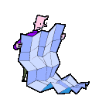
Where Are We Now?
Assessment
Middle School: Journey to the Bus Stop
High School: Four Situations, Another Four Situations
Notes:
Pre-and Post-Assessment options provided in Functions in Everyday Situations
http://map.mathshell.org/materials/lessons.php?taskid=430&subpage=concept
The middle school lesson provides Journey to the Bus Stop as a pre and post assessment opportunity.

Slide 9
Progressions
Performance Assessment
  Read assigned Progressions document
  Connect and highlight key ideas
  Use chart paper and markers
  In groups, prepare a five-minute engaging presentation for large group
  Present summary
  Pose questions for group discussion
Notes:
Break into Groups.
Discuss Assigned Progression document:
(1) Expressions & Equations 6-8
(2) Ratios and Proportional Relationships 6-7
(3) Statistics and Probability 6-8
(4) Statistics and Probability 9-12
How does it all fit in?
http://commoncoretools.files.wordpress.com/

Slide 10
Key Shifts
Focus
Coherence
Fluency
Deep Understanding
Application
Dual Intensity
Notes:
Distribute Key Shifts Handout
Key Shifts refer to What Students and Teachers Need to be Doing.
More information on the next slide.

Slide 11
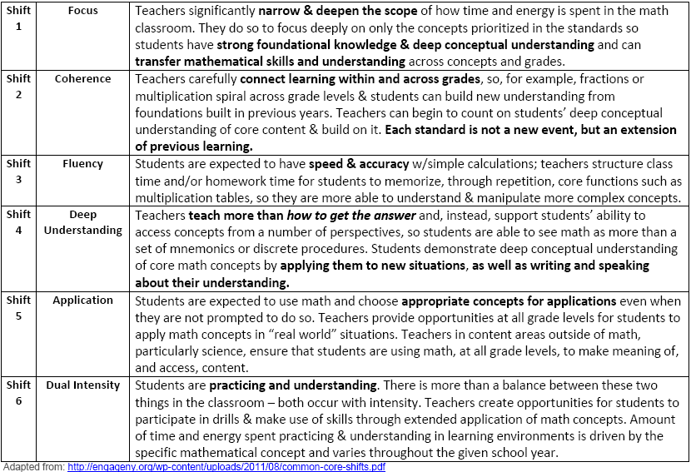
Dual Intensity
Notes:
Key Shifts in CCSS Mathematics from engageNY
Discuss shifts that happen in the Progressions from Gr 6-12: Coherence
Discuss the shift needed to make the Mathematical Practices a reality that will result in Deeper Understanding through more Focused lessons.
Discuss expected Fluencies and balance between practice and deep understanding that is discussed in Dual Intensity.
What kind of Lessons will move us forward?

Slide 12
Math Class Needs a Makeover
Dan Meyer,
High School Math Teacher
http://www.ted.com/talks/dan_meyer_math_curriculum_makeover.html
Notes:
From a TED Talk by Dan Meyer, March 2010
11:39 min video

Slide 13
Thinking
Out of the Box
One Teacher
http://blog.mrmeyer.com/
Notes:
Discuss: Math Class Needs a Makeover
Does the video inspire you to teach the way Dan describes?
We will try a Dan Meyer Three-Act Lesson.
Show the blog, the three-act-spreadsheet

Slide 14

Got Caffeine?
http://threeacts.mrmeyer.com/hotcoffee/
Notes:
Show the first act.
Let teachers brainstorm questions that students could ask and solve.
Show the questions on the Three Act
Show the second and third act.
Ask teachers what would happen if they used video questions to inspire?

Slide 15
Is Everything Functional?
What Different Ways
Do You Use to
Assess Student Learning?
Notes:
Ask teachers to answer this question for themselves on a piece of paper.
Share with a partner
Model Think –Ink- Pair-Share

Slide 16
What’s Next?
Common Assessments
Common Core State Standards are critical, but it is just the first step
Common assessments aligned to the Common Core will help ensure the new standards truly reach every classroom
http://www.parcconline.org
Notes:
TALKING POINTS
While the Common Core State Standards are a critical first step, they alone will not bring about the instructional changes necessary to improve student achievement and attainment. Creating common assessments grounded in common standards is the logical next step and will ensure the new standards truly reach every classroom
I think we will all agree that the current system is broken. Every state develops their own assessments and for that reasons our nation’s assessments:
Are of varying quality and rigor and rarely point toward College- and Career-Readiness.
Do not provide meaningful, real-time data for our educators, parents and policymakers
Cannot be compared from state to state, ensuring that students in Mass. And Miss. are receiving the same foundation
Next generation assessments will:
Provide a more complete picture of student performance against college- and career-ready expectations
Use current and future technologies to provide a meaningful assessment and useful data
Mitigate Challenges associated with mobility—which is a major challenge in education
U.S Department of Education set aside $350 million of Race to the Top funding for awards to consortia of states to design and develop common K-12 assessment systems aligned to common, college- and career-ready standards. In Sept. 2010, the U.S. Department of Education awarded grants to the Partnership for Assessment of Readiness for College and Careers (PARCC) and Smarter Balanced Assessment Consortium (SBAC)

Slide 17




PARCC Assessment Design
English Language Arts/Literacy and Mathematics, Grades 3-11
Optional Assessments/Flexible Administration
Diagnostic Assessment
Early indicator of student knowledge and skills to inform instruction, supports, and PD
Mid-Year Assessment
Performance-based
Emphasis on hard-to-measure standards
Potentially summative
Performance-Based
Assessment (PBA)
Extended tasks
Applications of concepts and skills
End-of-Year
Assessment
Innovative, computer-based items
ELA - Speaking And Listening
Assessment
Locally scored
Non-summative, required
Summative,
Required assessment
Interim, optional assessment
http:www.parcconline.org
Notes:
TALKING POINTS
Graphic depiction of the assessment system. The system includes a suite of assessments and tools that, taken together, provide a more complete picture of student mastery of standards and progress throughout the year than is currently available on state assessments.
Considerations Leading to 2 optional assessments:
The cost of the assessments
Flexibility on when to administer the optional assessments
The amount of testing time needed to administer the assessments
Possible disruption to school schedules caused by through-course assessment preparation and administration
Constraints the distributed design might have on the flexibility of state and local educators to sequence instruction of the CCSS and to implement their own benchmark and formative assessment initiatives
The PARCC assessment system will:
Reflect the sophisticated knowledge and skills found in the English and math Common Core State Standards
Include a mix of item types (e.g., short answer, richer multiple choice, longer open response, performance-based)
Make significant use of technology
Include testing at key points throughout the year to give teachers, parents and students better information about whether students are on track or need additional support in particular areas
Taken together, the PARCC assessment components comprise a comprehensive system of assessments that will provide timely information to teachers throughout the year, and provide students with meaningful information about their progress toward college and career readiness

Slide 18
PARCC Timeline
SY 2012-13
First year pilot/field testing and related research and data collection
SY 2013-14
Second year pilot/field testing and related research and data collection
SY 2014-15
Full administration of PARCC assessments
Summer 2015
Set achievement levels, including college-ready performance levels
SY 2010-11
Launch and design phase
SY 2011-12
Development begins
http://www.parcconline.org

Slide 19

Overwhelmed?
http://www.youtube.com/watch?v=BbX44YSsQ2I
Despite What a Crowd Thinks,
It’s Okay to Call for Help!?!
http://www.youtube.com/watch?v=YoTIaRyGzac
Notes:
When Not Knowing Math Can Cost You $15,000
Math 911 Call

Slide 20
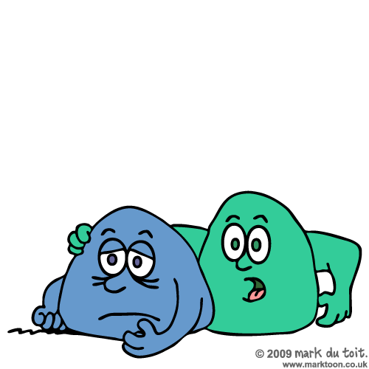
Help is Available
Grants & Awards
Recommended Resources
Graphic by Mark duToit, used w/permission: http://www.marktoon.co.uk
Notes:
Discuss and highlight:
Grants & Awards for Math Teachers Handout
Recommended CCSS Math Resources Handout

Slide 21

Run Diagnostic Checks
Got Questions?
Got Comments?
Please fill out the feedback form
Thanks!

Slide 22

Thanks for the ride!
Alanna Mertens
almertens@cps.k12.il.us
Pat Reisdorf
preisdor@kidsroe.org
Notes:
Collect Feedback Sheets

