Slide 1
Professional Development Modules: English Learner Tool Kit Chapter Nine - Evaluation of EL Programs
[presenter]
[date]

Slide 2
Purpose
The Professional Development Modules: English Learner Tool Kit is a series of presentations intended to provide guidance to help local educational leaders meet their legal obligations to English learners (EL) and enhance existing EL practices to meet the needs of all EL students, parents, and families.
Notes:
This professional development power point module is one of a ten-part series designed to introduce viewers to the English Learner Tool Kit, which provides an overview of legal obligations that schools/districts must address in supporting the educational needs of English learners (ELs). This series frames federal and civil rights requirements with related Illinois statute requirements for statewide implementation.
The Professional Development Modules: English Learner Tool Kit are a facilitator’s guide and a resource tool. These PD Modules can also be used as a teacher support with suggestions and references to encourage inclusionary practices to ensure equity and access for English learners.
The key objectives of the Professional Development Modules: English Learner Tool Kit include:
Expand knowledge on legal obligations to meet the needs of English learners
Implement inclusionary practices for equity and access for all English learners
Provide a resource and tool for professional learning
Serve as a companion and supplemental resource to legal guidance (“Dear Colleague Letter, OCR 2015” from US Department of Education)
Integrate Illinois-specific requirements for English learners
Each of the 10 self-paced PD Modules will include links to additional resources that can be downloaded.
Facilitators can download the EL toolkit at: https://www2.ed.gov/about/offices/list/oela/english-learner-toolkit/index.html

Slide 3
English Learner Tool Kit Topics
Identifying All ELs
Language Assistance Programs
Staffing and Supports
Meaningful Access
Inclusive Environment
ELs with Disabilities
ELs Who Opt Out of Programs
Monitoring and Exiting EL Programs
Evaluation of EL Programs
Communication with EL Parents
Notes:
This list is an overview of the ten topics that will be covered within the ten Professional Development Modules: English Learner Tool Kit. These happen to be the most commonly overlooked (or violated) areas across the country.
This module focuses on Chapter 9: Evaluating the Effectiveness of a District’s EL Program.

Slide 4
Significant Legal History
Title VI of the Civil Rights Act, 1964
Prohibits discrimination on the grounds of race, color, or national origin by recipients of federal financial assistance.
The Title VI regulatory requirements have been legally interpreted to prohibit denial of equal access to education because of a language minority student's limited proficiency in English.
Notes:
This is a significant legal obligation. Title VI of the Civil Rights Act lays the foundation for prohibiting all aspects of discrimination and it has been legally interpreted to protect English learners (formerly labeled as Limited English Proficient - LEP, but changed to EL with passage of ESSA to eliminate deficit-labeling language).

Slide 5
Significant Legal History
Lau v. Nichols Court Case, 1974
Case dealt with San Francisco school system’s failure to provide English language instruction to 1,800 students of Chinese ancestry.
U.S. Supreme Court unanimously ruled that a lack of supplemental instruction for English learners denies them a meaningful opportunity to participate in educational programs, which violates the Civil Rights Act of 1964.
Notes:
Lau v. Nichols
Probably the most important legal event for bilingual education was the Lau v. Nichols case, which was brought against the San Francisco Unified School District by the parents of nearly 1,800 Chinese students. It began as a discrimination case in 1970 when a poverty lawyer decided to represent a Chinese student who was failing in school because he could not understand the lessons and was given no special assistance. The school district countered that its policies were not discriminatory because it offered the same instruction to all students regardless of national origin. The lack of English proficiency was not the district’s fault.
Lower courts ruled in favor of the San Francisco schools, but in 1974 the U.S. Supreme Court ruled unanimously in favor of the plaintiffs. In his opinion, Justice William O. Douglas stated simply that “there is no equality of treatment merely by providing students with the same facilities, textbooks, teachers, and curriculum; for students who do not understand English are effectively foreclosed from any meaningful education.” The Court cited Title VI of the Civil Rights Act, noting that the students in question fall into the protected category established therein. (More information on Lau v. Nichols can be found at: https://www2.ed.gov/about/offices/list/ocr/ell/lau.html)

Slide 6
Significant Legal History
Equal Educational Opportunities Act (EEOA), 1974
Prohibits states from denying equal educational opportunity to an individual on account of his or her race, color, sex, or national origin.
The statute specifically prohibits states from denying equal educational opportunity by the failure of an educational agency to take appropriate action to overcome language barriers that impede equal participation by its students in its instructional programs.
Notes:
EEOA takes Title VI to a very specific level focused in education and mandates that education institutions cannot deny equal educational opportunity to its students.

Slide 7
“There is no equality of treatment merely by providing students with the same facilities, textbooks, teachers, and curriculum; for students who do not understand English are effectively foreclosed from any meaningful education.”
”
—Justice William Douglas
Notes:
Bottom line implication for ELs from Title VI Civil Rights, EEOA, plus Lau v. Nichols: All districts in the country must provide ELs meaningful access to educational content and programs in a language that they understand. Typically, this requirement is met through native language support or bilingual programs.
Subsequently, another significant case law is known as Castañeda v. Pickard. This case resulted in defining a useful three-prong test for bilingual program implementation criteria:
Must be based on sound educational theory,
Effective implementation with appropriate resources, and
Demonstrate successful outcomes.

Slide 8
Legal Obligations
U.S. Department of Education’s Office of Civil Rights (OCR) and the U.S. Department of Justice (DOJ) share enforcement authority.
Issued joint guidance in 2015 to help states, districts, and schools meet legal obligations to ELs.
Guidance identifies 10 common civil rights issues for English learners.
Notes:
Important things to note include:
OCR and DOJ share authority for enforcing Title VI in the education context.
DOJ is responsible for enforcing the EEOA.
The U.S. Department of Education (ED) also administers Title III, Part A of the English Language Acquisition, Language Enhancement, and Academic Achievement Act (https://www2.ed.gov/policy/elsec/leg/esea02/pg40.html).
The guidance applies to:
State education agencies,
Local education agencies, and
Any “school district” that is a recipient of federal financial assistance from ED, including public school districts, charter schools, and alternative schools.

Slide 9
Evaluating the Effectiveness of a District’s English Learner Program

Slide 10
ENGLISH LEARNER TOOLKIT Chapter 9: Tools and Resources for Evaluating the Effectiveness of a District’s EL Program
KEY POINTS
Successful EL programs enable EL students to attain both English proficiency and parity of participation in the standard instructional program within a reasonable period of time.
LEAs should collect longitudinal data to monitor and compare the performance of current ELs, former ELs, and never-ELs in the LEA’s standard instructional program. Data should not be limited to data collected for ESSA accountability purposes.
When EL programs do not produce both English proficiency and parity of participation within a reasonable period of time. SEAs and LEAs must modify the EL program.
Notes:
Research shows that effective programs for ELs provide sustained systems of support. Districts should periodically evaluate their EL programs to determine their effectiveness. Evaluation should focus on all aspects of EL programming including policies, procedures, programs, practices, resources, staffing, and student outcomes. Student achievement data is necessary to determine an EL program’s effectiveness and ensure compliance with state and federal reporting requirements. An evaluation of an EL program should be continuous and include multiple data points on ELs. If evaluations show that EL programs are not effective, the district must make appropriate programmatic changes. The following tools are intended to assist with evaluating programs and services for ELs.

Slide 11
You can access Tools and Resources for Evaluating the Effectiveness of an EL Program at http://www2.ed.gov/about/offices/list/oela/english-learner-toolkit/index.html.
Checklist for Evaluating the Effectiveness of an EL Program
To what extent is the LEA tracking data, both periodically and longitudinally, and by EL program, on ELs’ acquisition of English proficiency and mastery of grade-level content?
To what extent is the EL program meeting its stated educational goals without unnecessarily segregating EL students from never-EL students?
Do all ELs have comparable access to opportunities that prepare them for college and careers (e.g., higher-level courses, extracurricular activities, field trips, etc.) as their never-EL peers?
Notes:
This checklist is intended to assist with evaluating the effectiveness of programs and services for ELs. The full checklist can be found here: http://www2.ed.gov/about/offices/list/oela/english-learner-toolkit/index.html

Slide 12
Checklist for Evaluating the Effectiveness of an EL Program, continued
Are ELs making progress toward achieving language proficiency within a reasonable period of time, as evidenced by multiple performance indicators?
To what extent do longitudinal data compare performance in the core-content areas (e.g., via valid and reliable standardized tests), and graduation, drop-out, and retention data among current ELs, former ELs, and never-ELs?
To what extent are EL students meeting exit criteria and being exited from EL programs within a reasonable period of time?
Are all ELs receiving EL services until they achieve English proficiency and not exited from these services based on time in the EL program or opted-out status?
Notes:
(Checklist Continued) The checklist is intended to assist with evaluating the effectiveness of programs and services for ELs. The full checklist can be found here: http://www2.ed.gov/about/offices/list/oela/english-learner-toolkit/index.html

Slide 13
Checklist for Evaluating the Effectiveness of an EL Program, continued
Is the LEA tracking data of former ELs over time and is it able to compare that data to that of their never-EL peers? For example, to what extent do grades and state and local assessment data in the core-content areas indicate that former ELs:
participate meaningfully in classes without EL services?
perform comparably to their never-EL peers in the standard instructional program?
Do LEAs modify EL programs when longitudinal performance data indicate ELs are not reaching English proficiency within a reasonable period of time, or when former ELs are not participating in the standard instructional program comparable to their never-EL peers?
Notes:
(Checklist Continued) The checklist is intended to assist with evaluating the effectiveness of programs and services for ELs. The full checklist can be found here: http://www2.ed.gov/about/offices/list/oela/english-learner-toolkit/index.html

Slide 14
Pause and Reflect
What data do we need to make informed educational decisions regarding our EL program? How and where can we obtain the data?
What formal process do we have in place to regularly analyze our EL program and give opportunities for program stakeholders to provide feedback?
What data management system is in place to collect and maintain our data throughout the school year?
Notes:
Building and district leaders may choose to collect the pause and reflect responses. This would be serve as data to also pause and reflect about your English learner programming options.

Slide 15
Additional Resources to consider From the EL Toolkit

Slide 16
Evaluating the Effectiveness of an EL Program - Tools
Available at http://www2.ed.gov/about/offices/list/oela/english-learner-toolkit/index.html.
Tool #1, Evaluating Programs and Services for English Learners, offers suggested topics and questions for EL program evaluation.
Tool #2, Not applicable to districts.
Tool #3, Improving LEA Systems to Support English Learners, provides information that may help LEAs strengthen their EL programs.
Tool #4, Improving School-Based Systems for English Learners, provides information that may help schools strengthen their EL programs.
Notes:
The following tools are intended to assist schools, and districts in evaluating EL programs and services. The sample tools provide guidelines and specific examples of program elements to evaluate.
The Toolkit contains examples of, adaptations of, and links to resources created and maintained by other public and private organizations. This information is included here to offer examples of the many resources that educators, advocates, and other concerned parties may find helpful and use at their discretion. Available at http://www2.ed.gov/about/offices/list/oela/english-learner-toolkit/index.html.

Slide 17
Tool #1
Evaluating Programs and Services for English Learners
This tool offers suggested topics and questions for EL program evaluation:
http://www2.ed.gov/about/offices/list/ocr/ell/programeval.html
Notes:
It is important that evaluations of EL programs and services focus on overall and specific student learning goals. The goals should address expected progress in English language development and core-content instruction. The following tool is based on the U.S. Department of Education’s Office for Civil Rights’ Web page “Developing Programs for English Language Learners,” located at the following address: http://www2.ed.gov/about/offices/list/ocr/ell/programeval.html.
It may help districts identify elements for evaluating EL programs and services. Questions and data sources focus on EL program implementation information, staffing and professional learning; student performance in English language development and academic content areas, and analyzing the information collected and identifying areas for improvement. EL program evaluation will vary from district to district.

Slide 18
Tool #3
Improving LEA Systems to Support English Learners
This tool may help SEAs evaluate various aspects of their EL programs and services, collect data, and inform instructional program decisions for ELs.
SEVEN DIMENSIONS OF
AN LEA’S NEEDS ASSESSMENT:
THE PROMOTING EXCELLENCE APPRAISAL SYSTEM (PEAS)
Leadership
Personnel
Professional Development
Instructional Program Design
Instructional Implementation
Assessment and Accountability
Parent and Community Outreach
https://www.researchgate.net/publication/235625353_Evaluation_of_Arlington_Public_Schools_Programs_for_English_Language_Learners
Notes:
Evaluating the effectiveness of EL programs and services is essential for ensuring that districts meet the needs of all ELs. The following tool may help districts evaluate various aspects of their EL programs and services, collect data, and inform instructional program decisions for ELs.
The Promoting Excellence Appraisal System (PEAS) was developed by the George Washington University Center for Equity and Excellence in Education to support higher achievement among ELs. The system comprises seven dimensions and corresponding standards of practice: leadership, personnel, professional development, instructional program design, instructional implementation, assessment and accountability, and parent and community outreach.
The following tool is excerpted from one dimension—instructional program design. In this tool, the term “ELL” (English Language Learner) is used to refer to “EL” (English Learner).
Source: Acosta, B., Marzucco, L., Bayraktar, B., & Rivera, C. (2012). Evaluation of English learner programs in Alexandria City Public Schools. Washington, DC: The George Washington Center for Equity and Excellence in Education. Retrieved from http://www.acps.k12.va.us/curriculum/ell/gwu-report.pdf

Slide 19
Tool #3 continued
Improving LEA Systems to Support English Learners
The following tool is excerpted from one of the seven dimensions—Instructional Program Design. In this tool, the term “ELL” (English Language Learner) is used to refer to “EL” (English Learner).
Notes:
This is a continuation of Tool #3.

Slide 20
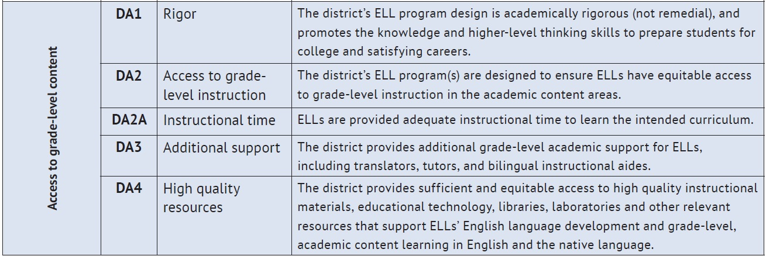
Tool #3 continued
Improving LEA Systems to Support English Learners
The following tool is excerpted from just one of the seven dimensions—Instructional Program Design. In this tool, the term “ELL” (English Language Learner) is used to refer to “EL” (English Learner).
Notes:
This is a continuation of Tool #3.

Slide 21
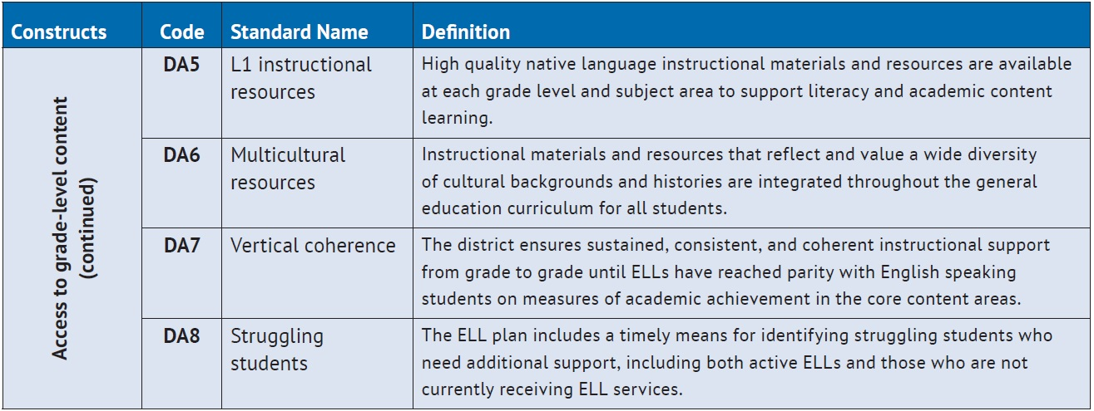
Tool #3 continued
Improving LEA Systems to Support English Learners
The following tool is excerpted from one of the seven dimensions—Instructional Program Design. In this tool, the term “ELL” (English Language Learner) is used to refer to “EL” (English Learner).
Notes:
This is a continuation of Tool #3.

Slide 22
Pause and Reflect
How can the Performance Evaluation Appraisal System (PEAS) and the seven dimensions of an LEA’s needs assessment support our EL Program?
What professional development opportunities are available to maximize improvements in our EL Program?
How can parent and community outreach assist us with efforts to improve our EL Program?
Notes:
Building and district leaders may choose to collect the pause and reflect responses. This would be serve as data to also pause and reflect about your English learner programming options.

Slide 23
Tool #4
Improving School-Based Systems for English Learners
http://ies.ed.gov/ncee/edlabs/regions/northeast/pdf/REL_2014027.pdf
Source: Grady, M. W., & O’Dwyer, L. M. (2014). The English language learner program survey for principals (REL 2014-027). Washington, DC: U.S. Department of Education, Institute of Education Sciences, National Center for Education Evaluation and Regional Assistance, Regional Educational Laboratory Northeast & Islands.
Notes:
Evaluating the effectiveness of EL programs and services is essential for ensuring that schools meet the needs of all ELs. The following tool may help schools evaluate various aspects of their EL programs and services, collect data, and inform instructional program decisions for ELs.
Regional Educational Laboratory Northeast & Islands (REL-NEI), administered by the Education Development Center, and the English Language Learners Alliance developed a survey to collect consistent data on EL programs and students. The survey is designed for school principals and covers EL programs, policies, and practices. The survey itself is a multi-page document. Below is an overview of its domains and the information obtained by each domain. Both schools and districts may wish to use the survey as a planning tool for providing school leaders professional learning opportunities about ELs. “ELL” (English Language Learner) is sometimes used to refer to “EL” (English Learner).
http://ies.ed.gov/ncee/edlabs/regions/northeast/pdf/REL_2014027.pdf

Slide 24
Background Resources
Fact sheet on the responsibilities of school districts
Fact sheet answering common questions about the rights of limited English proficient parents and guardians
Original OCR/DOJ guidance in “Dear Colleague” letter
Translations into multiple languages
All available at https://www2.ed.gov/about/offices/list/ocr/ellresources.html
Companion toolkit from the Dept. of Education Office of English Language Acquisition: https://www2.ed.gov/about/offices/list/oela/english-learner-toolkit/index.html
Notes:
Background resources are accessible to district and building leaders and staff. Parent resources are available in multiple languages. Additionally, English learner program self-evaluation tools are available to support deeper conversations within your district.
The listed resources can be downloaded at https://www2.ed.gov/about/offices/list/ocr/ellresources.html.
District and school leaders may wish to review and share the resources with staff to support development and implementation of EL initiatives and programs in their buildings. The companion toolkit which can be downloaded at https://www2.ed.gov/about/offices/list/oela/english-learner-toolkit/index.html can provide further support for implementation.

Slide 25
Evaluating the Effectiveness of an EL Program - Resources
Complete list available at http://www2.ed.gov/about/offices/list/oela/english-learner-toolkit/index.html.
Acosta, B., Marzucco, L., Bayraktar, B., & Rivera, C. (2012). Evaluation of English learner programs in Alexandria City Public Schools. Washington, DC: The George Washington Center for Equity and Excellence in Education. Retrieved from http://www.acps.k12.va.us/curriculum/ell/gwu-report.pdf
August, D., Salend, S., Staehr Fenner, D., & Kozik, P. (2012, July). The evaluation of educators in effective schools and classrooms for all learners. Washington, DC: AFT. Retrieved from *http://connectingthedots.aft.org/sites/aft/files/documents/i3_Grant-ELL- SWD_Working_Group-Shared_Values_Paper-FINAL-7-3-12.pdf
Baker, S., Lesaux, N., Jayanthi, M., Dimino, J., Proctor, C. P., Morris, J., Gersten, R., Haymond, K., Kieffer, M. J., Linan-Thompson, S., & Newman-Gonchar, R. (2014). Teaching academic content and literacy to English learners in elementary and middle school (NCEE 2014-4012). Washington, DC: U.S. Department of Education, Institute of Education Sciences, National Center for Education Evaluation and Regional Assistance (NCEE). Retrieved from http://ies.ed.gov/ncee/wwc/practiceguide.aspx?sid=19
Calderón, M., Slavin, R., & Sánchez, M. (2011). Effective instruction for English learners. Future of Children, 21(1), 103-127. Retrieved from http://www.princeton.edu/futureofchildren/publications/docs/21_01_05.pdf
George Washington University Center for Equity and Excellence in Education. (1994). Promoting excellence: Ensuring academic success for English language learners—Guiding principles. Washington, DC: Author. Retrieved from http://www.cgu.edu/include/guidingprinciples.pdf
Giancola, S. (2014). Evaluation matters: Getting the information you need from your evaluation. Washington, DC: U.S. Department of Education, Office of Secondary and Elementary Education, School Support and Rural Programs. Retrieved from http://www2.ed.gov/about/offices/list/oese/sst/evaluationmatters.pdf
Grady, M. W., & O’Dwyer, L. M. (2014). The English language learner program survey for principals (REL 2014-027). Washington, DC: U.S. Department of Education, Institute of Education Sciences, National Center for Education Evaluation and Regional Assistance, Regional Educational Laboratory Northeast & Islands. Retrieved from http://ies.ed.gov/ncee/edlabs/regions/northeast/pdf/REL_2014027.pdf
Hill, P., Murphy, P., & Redding, S. (2013, May). The SEA of the future: Leveraging performance management to support school improvement. Building State Capacity and Productivity Center, 1(1). Retrieved from http://www.bscpcenter.org/sea/pdf/sea_of_the_future%20_vol_1_052113.pdf
Notes:
The U.S. Department of Education and the Illinois State Board of Education do not mandate or prescribe particular curricula, lesson plans, or other instruments. The Tool Kit contains examples of, adaptations of, and links to resources created and maintained by other public and private organizations. This information is provided for the reader’s convenience and is included here to offer examples of the many resources that educators, parents, advocates, administrators, and other concerned parties may find helpful and use at their discretion. The U.S. Department of Education does not control or guarantee the accuracy, relevance, timeliness, or completeness of this outside information. Further, the inclusion of links to items does not reflect their importance, nor is it intended to endorse any views expressed, or materials provided. All links were verified on September 8, 2015.

