Slide 1
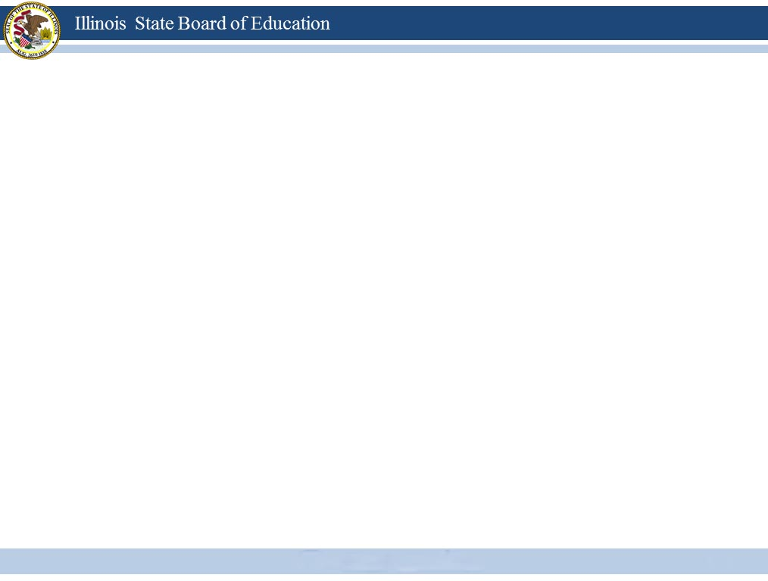


The Illinois Licensure System
ELIS
July 1, 2013
Notes:
Welcome to this initial presentation on the new Illinois Licensure System. This is the first in a series of tutorials that are designed to inform you of the changes that will occur as Illinois transitions to a licensure system by July 1, 2013.

Slide 2

The Exchange
Individuals need not do
anything to receive a new
license, but should renew
and register their current
certificates right up to the
exchange
All Illinois certificates
will be exchanged for
Illinois educator licenses
Transition to a licensure
system on July 1, 2013
Notes:
Illinois educator certificates have long caused confusion for teachers and administrators alike because it is not always clear what subjects the holder is qualified to teach or the grade levels to which the holder may be assigned.
In an effort to clarify this, Illinois will transition to a licensure system on July 1, 2013. All previously held certificates will no longer be valid for teaching in the public schools after that date. Be assured that you will lose nothing in the exchange and your new credentials will mirror what you currently hold.
On July 1, 2013, all Illinois certificates will be exchanged for educator licenses. Current certificate holders do not have to do anything to receive the new license because it will be automatic. Certificates that are held at the time of the exchange will be converted to endorsements on specific types of licenses. The subject area and grade levels for which the licensee is qualified to teach will be identified on your license.
If your current certificate renews in 2013, you are encouraged to complete the renewal requirements and register your certificate by June 1 to ensure a smooth transition.

Slide 3
Educator Licensure Information System
ECS
ELIS
Educator credentials will be listed in the new Educator Licensure Information System (ELIS) which will replace the current Educator Certification System (ECS) on July 1, 2013.
Notes:
Educators will not receive paper copies of their new licenses. Instead, each educator will find his or her credentials listed in the new Educator Licensure Information System (ELIS) which will replace the current Educator Certification System (ECS) on July 1, 2013.
Educators may print any page of ELIS if they wish to have a hard copy of their credentials.
Employers may use their access portal to verify each educator’s credentials.

Slide 4
Example of The Exchange
Type 75 Administrative Certificate | Professional Educator License (PEL)
Endorsements | Endorsements
General Administrative – Principal Endorsement Valid for Grades K – 12 | General Administrative Endorsement Valid for Grades K – 12
Information on The Credential
Type 03 Elementary Education Teaching Certificate
Endorsements
Valid for Self-contained Grades K – 9 | Elementary Education Valid for Self-contained Grades K – 9
Middle School Language Arts | Middle Level Language Arts
Middle School Mathematics | Middle Level Mathematics
Notes:
Here is an example of an exchange. This individual holds two certificates, a Type 75 Administrative Certificate and a Type 03 Elementary Teaching Certificate. These two certificates will exchange for one Professional Educator License (or PEL) which lists both previous certificates as “endorsements” on the PEL.
The endorsements include General Administrative Grades K – 12, Elementary Self-contained Teaching Grades K – 9, Middle Level Language Arts, and Middle Level Mathematics. Although the new credentials look somewhat different, nothing has been lost in the exchange.

Slide 5
Only Three Types of Licenses
Professional Educator License (PEL)
Educator License with Stipulations (ELS)
Substitute License
Current endorsements will transfer
to your new license, and it is possible
for you to hold multiple types of licenses.
Notes:
There are three types of licenses:
Professional Educator License (PEL),
Educator License with Stipulations (ELS) and
Substitute License.
Like anything else that is new, it will take a little time to get used to the terminology, but keep in mind that your credentials will not change. The appropriate endorsements will be transferred to each license you hold, and it is possible to hold multiple types of licenses. For instance, you may hold a Professional Educator License and a Substitute License.

Slide 6





Professional Educator License Endorsements
The license will be endorsed with specific areas and grade level ranges in which the holder is eligible to teach.
Notes:
To help take any guesswork out of interpreting educator credentials, each license will include the administrative or subject areas and grade levels in which the holder is qualified to hold positions.
For this first Exchange the previous credentials will be reflected on the license, so you may see “Middle Level” for the grade range. In the future, however, a person may see “Grades 5 – 8” in place of the words “Middle Level.”

Slide 7

Professional Educator License Endorsements
Requirements are determined by the type of endorsement and specified in administrative rule.
A subsequent endorsement for the same grade level may be added to the PEL.
Notes:
Subsequent endorsements, those issued after the initial license exchange, may be added to the Professional Educator License within the same level for which the licensee qualifies.
Requirements for an endorsement for the same grade range are determined by the type of endorsement and specified in administrative rule. All applicable content-area tests must also be passed before the endorsement may be issued.

Slide 8
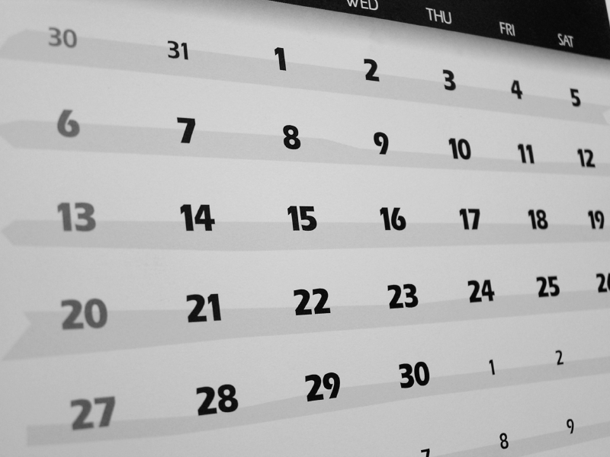
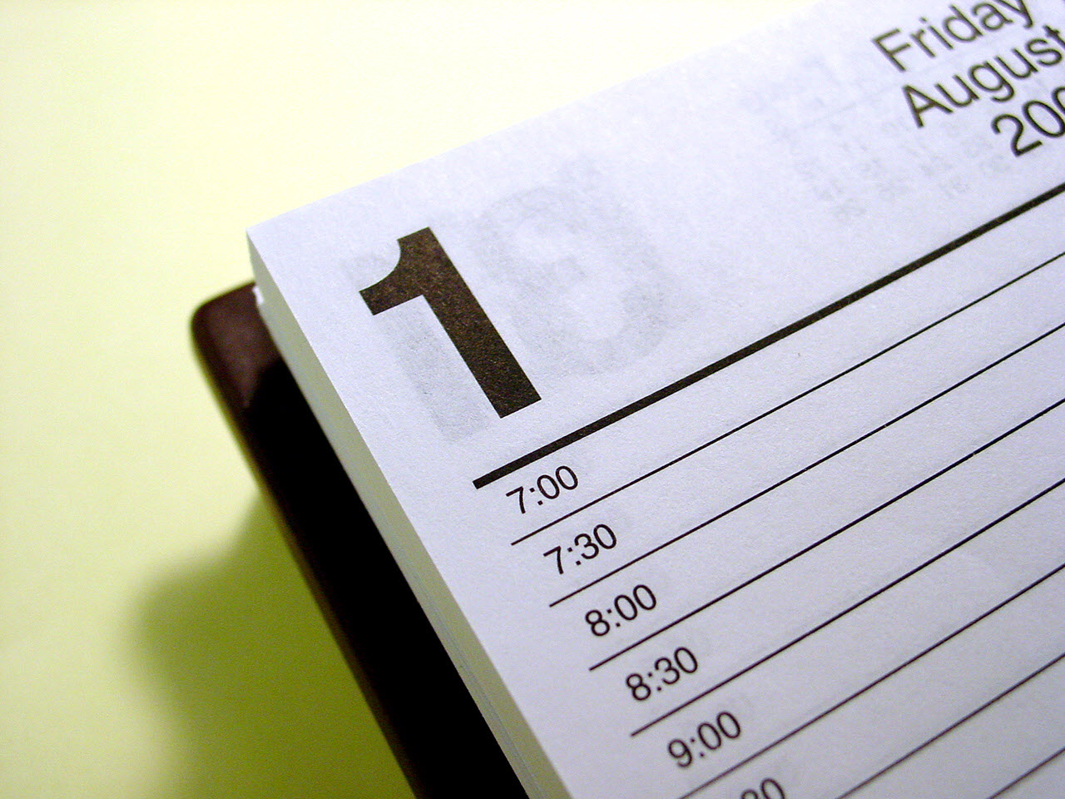



Renewal Cycles Will Not Change
July
New licenses
will be valid
for the
same time
period
as current
certificates.
Like certificates, all educator licenses
will lapse 6 months after the last
date of registration.
Renewal cycles
may vary for
different types
of licenses.
Professional Educator Licenses and
Educator Licenses with Stipulations
must be registered the same year that
the certificate is now scheduled to
renew.
Each type of license
will have to be
registered and a
separate fee paid.
JULY
Like certificates, all educator licenses
will lapse 6 months after the last date
of registration.
Notes:
Your new license will be valid for the same time period as your current certificate; It will have to be registered the same year your certificate is now scheduled to renew. You should check in ELIS in July to confirm your next registration date to make sure you do not miss it.
If you hold more than one type of license, each type will have to be registered and a separate registration fee paid. For instance, if you hold a Professional Educator License and an Educator License with Stipulations, you must pay a $50 registration fee for each license every 5 years, or a total of $100.
Just like certificates, educator licenses will lapse 6 months after the last registration date. In order to reinstate a lapsed license you must pay a $500 penalty or complete 9 semester hours of college coursework in the content area(s) identified on your credentials.

Slide 9

Initial Certificate
Initial Certificates will be exchanged for a Professional Educator License (PEL).
The license is valid for the time remaining
on the current certificate.
Registration fees must be paid to the
renewal date.
There are no requirements for moving
from the Initial Certificate to the PEL.
Keep documentation of any PD activities.
Notes:
If you currently hold an Initial Certificate, it will be exchanged for a Professional Educator License (PEL). The license will be valid for the time period remaining on your current certificate; for example it may be valid until 6/30/13 or 6/30/14.
You must log in to your ELIS account and pay any registration fees you owe to prevent the license from lapsing.
Even if you have not yet completed four years of teaching on your Initial Certificate, it will be exchanged for the PEL. There are no requirements for moving from the Initial Certificate to the PEL since “leveled” certificates no longer exist.
If you have completed four years of teaching this year (FY 2013) you do not have to apply for a Standard Certificate and pay the application fee. The Initial Certificate will be exchanged for the PEL at no cost.
If you have completed any professional development activities, keep your documentation in case you may use them to renew the license.

Slide 10

Standard Certificate – Exchanges
PD activities
Valid Time Period
Exchanges
Exchanges for a Professional Educator License (PEL) or an Educator License with Stipulations (ELS) depending
on the type(s) of certificate(s)
Notes:
Standard Certificates will be exchanged for a Professional Educator License (PEL) or an Educator License with Stipulations (ELS) depending on the types of certificates and endorsements you hold.
The license will be valid for the same time period as that remaining on your current certificate, and must be registered by that date to remain valid.
Since renewal requirements have not been finalized for the license, keep any documentation or Evidence of Completion Forms that you have in case those activities are eligible to renew your license.

Slide 11
Standard Certificate – Valid Time Period
Exchanges
PD activities
Valid Time Period
Valid for the time period remaining on the certificates and must be registered by that date
Notes:
Standard Certificates will be exchanged for a Professional Educator License (PEL) or an Educator License with Stipulations (ELS) depending on the types of certificates and endorsements you hold.
The license will be valid for the same time period as that remaining on your current certificate, and must be registered by that date to remain valid.
Since renewal requirements have not been finalized for the license, keep any documentation or Evidence of Completion Forms that you have in case those activities are eligible to renew your license.

Slide 12
Standard Certificate – PD Activities
Valid Time Period
Exchanges
PD Activities
PD activities documents should be kept in case such activities are eligible for license renewal.
Notes:
Standard Certificates will be exchanged for a Professional Educator License (PEL) or an Educator License with Stipulations (ELS) depending on the types of certificates and endorsements you hold.
The license will be valid for the same time period as that remaining on your current certificate, and must be registered by that date to remain valid.
Since renewal requirements have not been finalized for the license, keep any documentation or Evidence of Completion Forms that you have in case those activities are eligible to renew your license.

Slide 13

Administrative Certificate
Current administrative certificates will be
exchanged for an appropriate endorsement
on a Professional Educator License:
1) Director of Special Education;
2) General Administrative;
3) Chief School Business Official;
4) Superintendent; or
5) General Supervisory.
Notes:
Current administrative certificates will be exchanged for the appropriate endorsements on a Professional Educator License (PEL). What were formerly individual certificates will become endorsements on the license.
The administrative endorsements include:
Director of Special Education;
General Administrative;
Chief School Business Official;
Superintendent; and
General Supervisory.

Slide 14



General Administrative Endorsement
If the conversion to the
Principal endorsement
is not selected, the
GA endorsement on the
license will continue
to be valid for employment
in the same positions as
allowed with the certificate.
To qualify, one year
of administrative
experience is required
on a valid GA endorsement within the past five years.
May be converted
to the new Principal
endorsement upon
application by 7/1/2015.
1
Notes:
After the exchange, if a licensee qualifies, the General Administrative Endorsement may be “converted” to the new Principal Endorsement upon application by July 1, 2015. Application forms will be made available on the ISBE website in due time.
Applicants must have one year of experience as an administrator on a valid General Administrative Endorsement within the past five years to qualify for the Principal Endorsement. That means an applicant must have worked in any position requiring an administrative certificate by law .
If a licensee chooses not to convert, or is not eligible for the Principal Endorsement on the license, the General Administrative Endorsement will continue to be valid for employment in the same positions as allowed with the certificate.
The Principal Endorsement will be issued to those who are completing the new principal preparation programs.

Slide 15



Master Teaching Certificate
If an endorsement was placed on a Master Teacher Certificate previous to July 1, 2012, the certificate will be exchanged for a Professional Educator License (PEL) with the same endorsement.
The NBPTS designation will also be added to the license, but will remain on the license only while the licensee maintains NBPTS certification.
The licensee may
work as a teacher
in that endorsement
area.
Notes:
If you currently hold a Master Teacher Certificate with an NBPTS endorsement that was received previous to July 1, 2012, you will have your certificate exchanged for a Professional Educator License (PEL) with the same endorsement.
You may work as a teacher in that endorsement area even without being issued the Illinois endorsement required for that position.
The NBPTS designation will also be added to your license, but if you choose not to renew your Master Certificate with the National Board for Professional Teaching Standards, the NBPTS designation will be removed from your credentials. The endorsement will remain.
ALL Professional Educator Licenses are valid for 5 years.

Slide 16

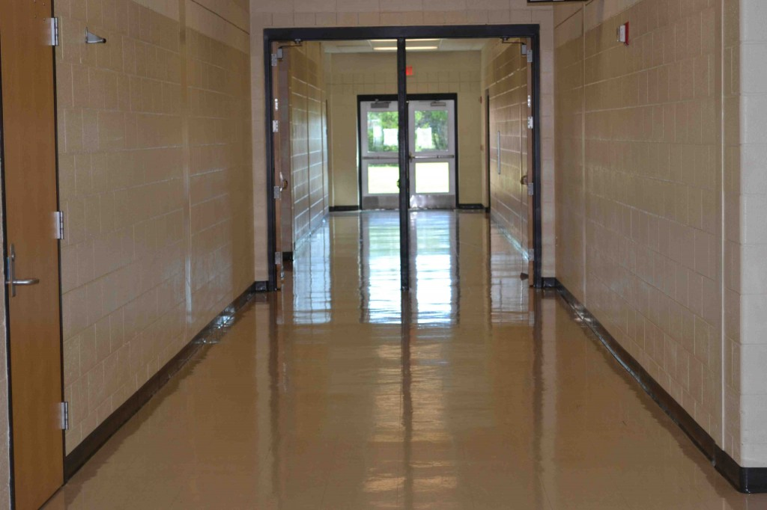
Master Teaching Certificate
If an NBPTS designation was added to a Master Teacher Certificate beginning July 1, 2012,
The licensee may work as a teacher only in an area where he/she holds the required Illinois endorsement.
the certificate will be exchanged for a Professional Educator License (PEL) with a Master Teacher (NBPTS) designation.
If the licensee chooses not to renew the
master certificate with the National Board for Professional
Teaching Standards, the NBPTS designation
will be removed from the credentials.
Notes:
If you currently hold a Master Teacher Certificate with an NBPTS designation issued after July 1, 2012, you will have your certificate exchanged for a Professional Educator License (PEL) with a Master Teacher (NBPTS) designation.
Any individual who is issued an NBPTS designation on a PEL after July 1, 2012 may work as a teacher only in a content area for which he or she holds the required Illinois endorsement.
The NBPTS Designation will remain on the license while the licensee maintains National Board for Professional Teaching Standards certification, but will be removed if the licensee fails to maintain the NBPTS certification.
ALL Professional Educator Licenses are valid for 5 years.

Slide 17
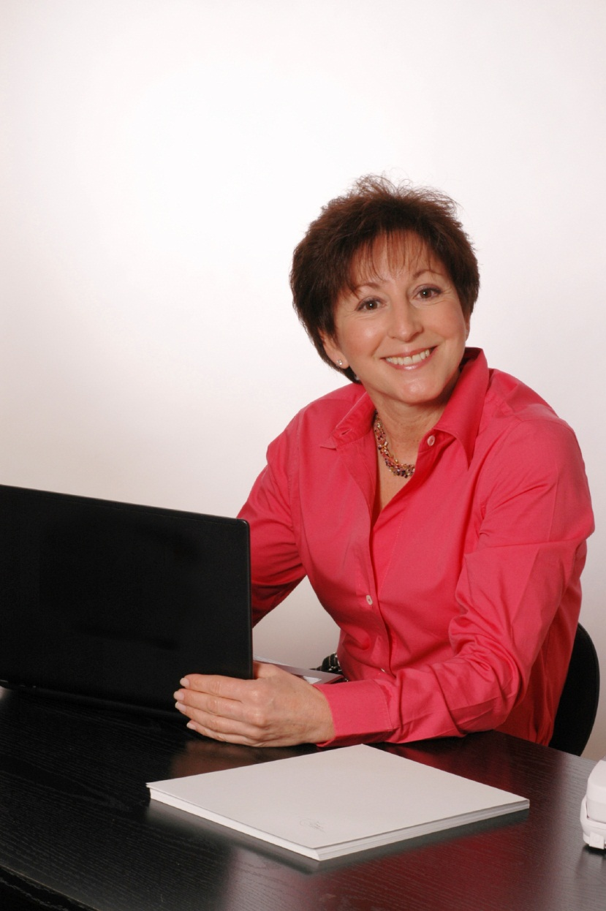
School Service Personnel Certificate
School Service Personnel Certificates will be exchanged for a Professional Educator License (PEL) with any of the following endorsements that apply:
1) School Counselor,
2) School Nurse,
3) School Social Worker,
4) School Psychologist, and/or
5) Speech and Language Pathologist
(non-teaching).
Notes:
Current School Service Personnel Certificate holders will have their certificates exchanged for a Professional Educator License (PEL) with any of the following endorsements that apply:
School Counselor;
School Nurse;
School Social Worker;
School Psychologist, and
Speech and Language Pathologist, which is a non-teaching license.

Slide 18

Substitute License
After the exchange, individuals holding a Substitute License must log in to ELIS and register it for all 5 years of the renewal cycle because the new license will be valid from July 1, 2013 to June 30, 2018.
That means if a person currently holds a substitute certificate that is valid until June 30, 2014, registration fees must be paid through 2018, which would be an additional $40.
Notes:
After the exchange, if you hold a Substitute License you will have to take action to maintain the validity of that license because ALL new Substitute Licenses will be valid for 5 years, from July 1, 2013 to June 30, 2018. Your current certificate will be registered for 1 to 4 more years, depending on when it was issued. Therefore, you must log in to the new ELIS system and register your license for the additional years - to total 5. You will receive credit for all registration you have paid in the past. That means you will owe between $10 and $40 in additional registration fees.
If you have never passed a test of basic skills, you must pass one before you renew your Substitute License in 2018. Once you pass the test for your first renewal, you are not required to take the test again for further renewals.
It is very important to understand that if you have had your Professional Educator License or Educator License with Stipulations suspended or revoked, or you have not met the renewal requirements for any license you hold, you will not be eligible to obtain a Substitute License.
Substitute Licenses are not eligible for endorsements.

Slide 19

Paraprofessional Approval
Individuals who hold national (NCLB) approval at the time of the exchange will receive a Paraprofessional Educator Endorsement on an Educator License with Stipulations, valid for 5 years.
Paraprofessionals who hold an Illinois letter of approval will not receive a license, but their approvals will remain valid indefinitely.
Notes:
Individuals who hold National (NCLB) approval at the time of the exchange will receive a Paraprofessional Educator Endorsement on an Educator License with Stipulations, valid for 5 years.
Paraprofessionals who hold an Illinois letter of approval will not receive a license, but their approvals will remain valid indefinitely.
Paraprofessionals who hold Illinois approvals may continue to work in positions as paraprofessionals in non-Title I funded programs.

Slide 20

Paraprofessional Approval
Paraprofessionals holding only the Paraprofessional Educator Endorsement on an Educator License with Stipulations must register the license, but are not subject to additional requirements in order to renew the license.
Educator
Licensure Information System - ELIS
Register online
Notes:
Individuals who hold an Educator License with Stipulations with only the Paraprofessional Educator Endorsement must register the license and pay the appropriate fees. Current registration fees are $10 per year.
However, licensees with the Paraprofessional Educator Endorsement are not subject to additional requirements in order to renew the license.
A paraprofessional holding the “state-only approval” may apply for the Educator License with Stipulations with a Paraprofessional Educator Endorsement if he/she 1) holds an associate’s degree or 2) has completed a minimum of 60 semester hours from a regionally accredited institution of higher education and has a high school diploma; or 3) has passed the ETS Parapro Test or the ACT Work Keys and has a high school diploma. Remedial and developmental courses may not be counted toward the 60 semester hours.

Slide 21
Educator Licenses in Exchange for Certificates and Approvals
If you would like to know specifically what certificates will be exchanged for an Educator License and the appropriate endorsements, please see Section 25. Appendix C Exchange of Certificates for Licenses
(July 1, 2013) at
http://www.isbe.net/rules/archive/pdfs/25ark.pdf
Notes:
If you are interested in knowing exactly what license and endorsements will be exchanged for your current certificates and endorsements, you may find that information in Appendix C of Part 25 rules. The website is listed here for your convenience.

Slide 22
Educator Licenses in Exchange for Certificates and Approvals
You may also want to learn more about additional approvals. If so, read Section 25.15 Types of Licenses: Exchange in the same document
http://www.isbe.net/rules/archive/pdfs/25ark.pdf
Notes:
Individuals who currently hold approvals or certain certificates may find something unique in the exchange that does not apply to all certificate holders.
Please refer to Section 25.15 of the rules which may be found in the same document as previously mentioned. Details of the exchange are explained there.

Slide 23

License Renewal
Maintain Evidence of Completion Forms and appropriate documentation for all professional development activities completed during the renewal period of the certificate in case it may be used for renewal of the license.
Approved Illinois Provider # 1234
Workshop for
Illinois Educators
Notes:
Until new statutes are adopted regarding renewal of the educator licenses, educators are advised to continue engaging in meaningful professional development. You should also maintain your Evidence of Completion Forms and appropriate documentation for all professional development activities completed during the validity period of the certificate/license.
Currently, approved providers may continue offering professional development activities until any new legislation takes effect.
Administrators should continue attending one Illinois Administrators’ Academy (IAA) course each year. All courses completed will transfer to the new ELIS database.

Slide 24
Suspended and Lapsed Certificates
Suspended or lapsed certificates at the time of the exchange will be exchanged for a license with the appropriate endorsements, but suspended or lapsed endorsements will be listed as “invalid” until reinstated.
Illinois Certificate
☑ Suspended
Illinois License
☑ Suspended
Notes:
Individuals holding suspended or lapsed certificates at the time of the exchange will receive a license with the appropriate endorsements, but the suspended or lapsed endorsements will remain invalid until reinstated.
No one may work in the Illinois public schools in a position requiring an appropriate license or endorsement if that license or endorsement is not valid and registered.

Slide 25

Suspended Licenses
If an individual has had his or her Professional Educator License or Educator License with Stipulations suspended or revoked, then that individual is not eligible to obtain
a new Substitute Teaching License.
No New Substitute License if you hold a Lapsed or Suspended License
Notes:
If you hold a suspended or revoked Professional Educator License or Educator License with Stipulations, or do not complete renewal requirements for your license, then you will not be able to obtain a new Substitute Teaching License.
However, any individual who already holds a Substitute Teaching License may renew it even though he or she has a suspended or revoked license of another kind.

Slide 26
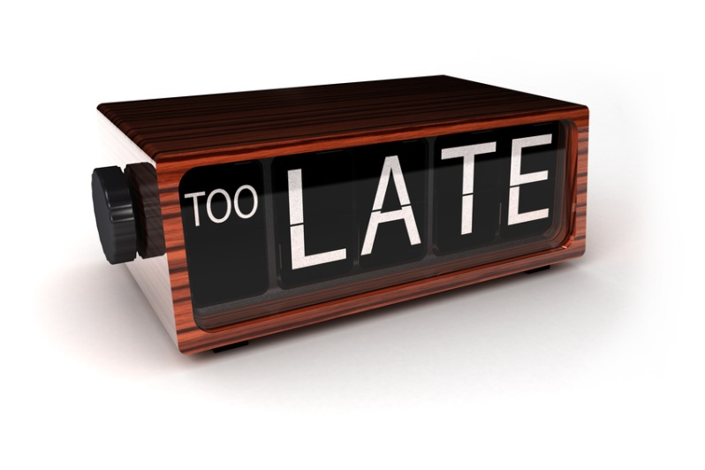
Lapsed Licenses
Individuals with lapsed Educator Licenses are not eligible to obtain
a new Substitute Teaching License.
Lapsed licenses will remain invalid until the licensee completes 9 semester hours of coursework or pays a $500 penalty fee and all back registration fees.
Notes:
An educator’s license will lapse if the licensee does not pay registration fees within 6 months of the last registration date, or fails to meet renewal requirements.
Individuals who hold a lapsed license do not qualify for a new Substitute Teaching License.
To reinstate a license, the holder must complete 9 semester hours of advanced coursework in a content area of the endorsement, or may pay a $500 penalty fee. With both options, licensees must also pay all back registration fees.
Individuals with lapsed licenses may not work in a position in a public school that requires that license.

Slide 27

Voluntary Surrender
May surrender one
or more endorsements on a Professional Educator
License or Educator License
with Stipulations.
All requirements at
the time of the new
application must be met.
One opportunity each
10 years to surrender endorsements.
May not apply for that same endorsement again for a period of 10 years.
Notes:
Licensees will have one opportunity each 10 years to voluntarily surrender one or more endorsements on a Professional Educator License or Educator License with Stipulations.
Once surrendered, the licensee may not apply for that same endorsement again for a period of 10 years, and all requirements at the time of the new application must be met which may mean taking additional college courses and passing the required state tests.

Slide 28

Your New Educator License
If you have any questions, please contact your
Regional Office of Education. The Directory of Regional Superintendents may be found online at
http://www.iarss.org/directory/areas.html
or
you may visit the ISBE website at
www.isbe.net/certification/default.htm
to keep updated with the latest information.
Notes:
The regional office of education serving your area will be happy to answer any questions you have. You may find the directory of those offices with contact information at the website listed here.
If you are employed with Chicago Public School District #299, your regional office is the Illinois State Board of Education. You may contact our office at 217/557-6763.
Please check the Illinois State Board of Education website regularly for updated information. The web address is listed here. You will also find updates when you log in to your ECS account and the new ELIS account.
Thank you for taking the time to learn about your new licensure system. Additional tutorials will explain more about the new system.

