Slide 1
Notes:
AT DOOR: Video Plays while participants enter the room.
http://www.youtube.com/watch?v=KDhvvo5FBTY

Slide 2
Collaborative Learning within the Common Core Classroom
An Experiential Workshop
STEP OUT
1
Notes:
AT DOOR: Now is the time to join your group. The stick you are given with multiple symbols attached corresponded to the symbols on the boxes at each table….please head to that group area now. (point to designated areas around the room)
WELCOME: (1 min)
F1 ‘Attention Please’ (you have 30 seconds from slide #1 starting before explosion)
“Welcome… [Pause for attention] YOU have chosen to JOIN us for an
experiential workshop on Collaborative Learning within the Common
Core Classroom. In addition to experiencing this fast-paced workshop,
we have prepared for you special “step out” moments to build your
capacity for development of future collaborations. These moments,
when we ‘STEP OUT’ of the role of facilitative teachers and into
the role of workshop trainers, are also listed on your take away handout
for convenience. You’ll note the ORANGE EXPLOSION on the screen
to mark these moments as well.
For example: Step Out #1 = random sorting process

Slide 3
TRAINING OBJECTIVES
1. Increase teacher understanding of steps
and stages for creating a collaborative
learning environment.
2. Increase teacher comfort with
collaborative learning implementation.
STEP OUT
2
Notes:
1.5 min
Training Objectives:
F1 Read ‘Training Objectives’
Step Out #2:
F2 Additional Pre-Training Details
Teachers facilitating collaboration:
- Encourage open ended discussions
- Design project and problem based tasks
- Use authentic methods
- Match tasks with students interests and zones
- Scaffold learning through peer interaction
- Encourage group reflection

Slide 4
Collaborative Learning Environments & Common Core
STEP OUT
3
WHY
HOW
NOW
Notes:
3 min
F1
When creating collaborative learning tasks, keep in mind
the six levels of Bloom’s cognitive taxonomy:
Divergent Thinking – Literacy of Tomorrow:
Remembering, Understanding, Applying,
Analyzing, Evaluating, Creating
F2
Wright et al. found that students in cooperative learning
classes “had quantifiably better reasoning and
communication skills” than students taught in
lecture/discussion classes.
STEP OUT #3:

Slide 5
WHY
HOW
NOW
Speaking and Listening standards for all grade levels.
ELA Standard 1 states that students must engage effectively in a range of collaborative discussions. (one-on-one, in groups and teacher led) They are to follow rules for collegial discussions, track progress toward specific goals and define individual roles.
Math practice standard 3 students are asked to construct viable arguments and critique the reasoning of others. All grades can listen or read the arguments of others, decide whether they make sense and ask useful questions to clarify or improve arguments.
Illinois social and emotional standard number 2 students are to use social-awareness and interpersonal skills to establish and maintain positive relationships.
Notes:
3 min
Collaborative Learning Environments & Common Core:
Collaboration and collegial discussions fit into the common core in several areas….
In ELA they can be found in Speaking and Listening standards for all grade levels. Standard 1 states that students must engage effectively in a range of collaborative discussions. (one-on-one, in groups and teacher led) They are to follow rules for collegial discussions, track progress toward specific goals and define individual roles.
In the Math practice standard 3 students are asked to construct viable arguments and critique the reasoning of others. All grades can listen or read the arguments of others, decide whether they make sense and ask useful questions to clarify or improve arguments.
Also in the Illinois social and emotional standard number 2 students are to use social-awareness and interpersonal skills to establish and maintain positive relationships.

Slide 6
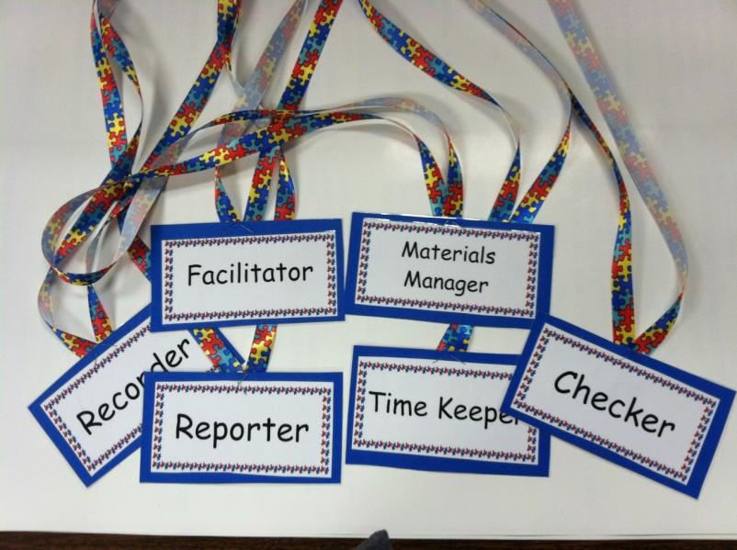
ROLES & NORMS
WHY
HOW
NOW
STEP OUT
4
Notes:
2 minutes –
Review Roles and Norms on Group Poster Boards
All members of the group should fee important
Goals are set at the beginning, everyone knows their responsibilities
Information and resources are accessible
Opportunities and time are relative to task size. Remember collaborating takes time.
STEP OUT #4:
Review set up of classroom culture that has identified and acknowledged group norms previously

Slide 7
COLLABORATIVE QUESTIONS
WHY
HOW
NOW
STEP OUT
6
STEP OUT
5
Notes:
17 mins – ‘GO’
DIRECTIVE: Material Managers choose and pick up question board.
“All facilitative teachers will be roaming between their assigned groups to facilitate.
STEP OUTS:
#5 - Facilitator Reminder Cards… Prep to help yourself ‘in the moment’… STAY ON TASK, KEEP GROUP ON TASK
#6 - Facilitative Group Work… LANGUAGE STEMS

Slide 8
Celebrate Your Collaboration!
WHY
HOW
NOW
STEP OUT
7
Notes:
10 mins –
DIRECTIVE: CHECKERS return all questions and all sticks back to facilitator now.
Round Robin – Each group shares their one question & two answers that they came up with.
Acknowledge to the group that we will forward all Questions and answers within one month.
Lead by F1, but involving other workshop leaders
STEP OUT #7:
Acknowledging work completed even when not a product… Conversation IS a product!
Remind: Group answers and take a ways and evaluation comments will be emailed within 30 days

Slide 9
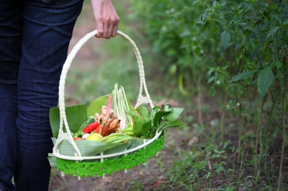
Group Harvest of ‘Take Aways’
(Please complete workshop Survey)
Notes:
8 min
Large Group Harvest + Workshop Survey (paper or digital)
STEP OUT #8:
Harvest bring closure and value to the work just completed and EVERYONE’s voice!!!
DIRECTIVE: please take a moment and find your workshop assessment/feedback form by PAPER, TEXT, or GOOGLE FORM
Appreciation
Adjournment

Slide 10
This presentation was
developed and presented by
The Comprehensive System
of Learning Supports Team
For more information, please visit
www.isbe.net/learningsupports

