Slide 1
Common Denominators within the Common Core
Dr. Bob Mann
Mathematics
Western Illinois University
rr-mann@wiu.edu www.wiu.edu/users/mfrrm1
ISBE Regional Common Core Conference 2012
www.CCSSMMann.pbworks.com

Slide 2
20th Century Clickers
Raise your right hand if you have some knowledge or familiarity with the Common Core State Standards

Slide 3
Survery says….
98% of you have some knowledge of CCSSM
2% are confused by the technology

Slide 4
Next question..
Raise your left hand if you would like to learn more about the standards and related assessments

Slide 5
Survery says….
94% of you would like to learn more
2% are delusional
4% are here just for the Air Conditioning

Slide 6
Another result….
56% of you are currently questioning your (or your neighbor’s) deodorant choice!

Slide 7
New question..
Raise your right hand if you know what BFF means….

Slide 8
Holiday Challenge
Regifting Robin Link

Slide 9
A Good Problem
One of the common themes continued with the Common core is
Problem-solving and the use of good problems
“Tasks and Talk”
“Work and Words”

Slide 10
Subtitle for this talk?
Common Core State Standards
Your new BFF???

Slide 11
But what about
F.BF
What does that mean???
Or RP? Or NBT?

Slide 12
There is a lot to learn…
Standards, domain, clusters
Conceptual categories, critical areas
Progressions, streams, trajectories
Frameworks, boundaries
Sequence…..
See Card and www.ccssmmann.pbworks.com

Slide 13
Goals for today
To help provide a clearer picture of the standards
To provide resources and sample tasks
To identify common themes between these standards and others

Slide 14
But first, some basics….
3 + 4 =
300 + 400 =
3 million + 4 million =
.3 + .4 =

Slide 15
and….
3 + 4 =
3 sheep + 4 sheep =
3 apples + 4 apples =
3/8 + 4/8 =
3x + 4x =

Slide 16
But what about…
3 sheep + 4 cows =
3 apples + 4 oranges =
3/8 + 1/2

Slide 17
The need for a common denominator…
3 sheep + 4 cows = 7 animals?
3 apples + 4 oranges = 7 pieces of fruit?
3/8 + ½ = 3/8 + 4/8 = 7/8

Slide 18
Common Denominators
Allow us to identify shared properties
Allow us to compare items at a common level
Allow us to combine otherwise ‘unlike’ terms

Slide 19
We need common denominators for the myriad of standards
Illinois Learning Standards
Illinois Teaching Standards
NCTM Standards
21st Century Skills and STEM
Many, many, more….
Common Core State Standards

Slide 20
And Related Reports
Glenn Report
A Nation At Risk
Adding it Up (National Research Council)
Calling for Change (MAA)
Foundations for Success (Math Panel)
Crisis at the Core (ACT)
Curriculum Focal Points (NCTM)
Many, many, many, more…
See http://faculty.wiu.edu/JR-Olsen/wiu/research/ed-res-1.htm

Slide 21
What are some commonalities?
CCSSM directly referred to and incorporated NCTM Process Standards and strands of mathematical proficiency in Adding It Up

Slide 22
Common Denominator 1:
Shift Happens
And
1a. Shift needs to Happen!

Slide 23
The need for STEM and the new Global Economy
“We are preparing students for jobs that don’t yet exist…
using technologies that haven’t yet been invented…
to solve problems we don’t even know are problems yet”
—Former Secretary of Education Richard Riley 2007

Slide 24
The Need for Shift
Low Proficiency Rates of NAEP
Low High School Grad. Rates
High College Remediation Rates
Low International Results
(See TIMSS and PISA)
Low PSAE pass rates in Illinois
Not Career and College Ready

Slide 25
ISAT PSAE Trends
Year | 3rd grade ISAT | 4th grade ISAT | 5th grade ISAT | 6th grade ISAT | 7th grade ISAT | 8th grade ISAT | 11th grade PSAE
2005 | 79 |  | 73 |  |  | 54 | 53
2006 | 86 | 85 | 79 | 79 | 76 | 78 | 54
2007 | 87 | 86 | 83 | 81 | 79 | 81 | 53
2008 | 85 | 85 | 81 | 83 | 80 | 80 | 53
2009 | 85 | 86 | 83 | 82 | 83 | 82 | 52
2010 | 86 | 86 | 83 | 85 | 84 | 84 | 53
2011 | 87 | 88 | 84 | 84 | 84 | 86 | 51

Slide 26
Some Perspective
NAEP math scores higher than ever
International results are improving
More students are going to college
ACT and SAT math have gone up
ACT scores in Illinois have improved
More students are taking more mathematics

Slide 27
Common Core Connection
For over a decade, research studies of mathematics education in high-performing
countries have pointed to the conclusion that the mathematics curriculum in the
United States must become substantially more focused and coherent in order to
improve mathematics achievement in this country.

Slide 28
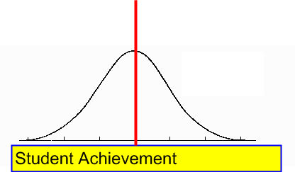
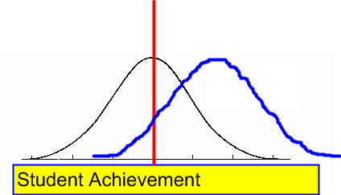
Common Denominator 1:
1. Shift Happens
And
1a. Shift needs to Happen!

Slide 29
2. Focus on Problem Solving
Critical Thinking Skills
Reasoning
HOTS
Informed Decision Making
NCTM’s Problem Solving Standard
“Make sense of problems and persevere in solving them.”

Slide 30
Students Can Do Basics, ...
347 + 453
90%
864 – 38
73%
Source: NAEP 1996
Notes:
PURPOSE: To illustrate the performance of grade 4 students on computation items from NAEP* 1996.
SPEAKING POINTS
Grade 4 students’ performance on two computation items. (The performance will be added in Power Point with another click; you may want to ask your audience to say what they think the performance is.)
INFORMATION ABOUT ITEMS
The first item was a multiple-choice item and the second item was constructed response*.
No calculator for these items.
These items are similar to unreleased items that had the following characteristics (two regroupings in the addition of two three-digit numbers, and a two-digit number subtracted from a three-digit number with regrouping only in the ones place.)
REFERENCES
See “Additional Resources” file: NAEP Fact Sheet
Kouba, Vicky L., and Diana Wearne. “Whole Number Properties and Operations.” In E.A. Silver & P.A. Kenny (Eds.) Results from the Seventh Mathematics Assessment of the National Assessment of Educational Progress. Reston, VA: NCTM (forthcoming).
*National Assessment of Education Progress
*Constructed Response: Student writes the short answer, it is not multiple choice.

Slide 31
… But Students Cannot Solve Problems
Ms. Yost’s class has read 174 books, and Mr. Smith’s class has read 90 books.
How many more books do they need to read to reach their combined goal of reading 575 books?
33%
Source: NAEP 1996
Notes:
PURPOSE: To contrast performance from previous example to a word problem requiring computation.
SPEAKING POINTS
This problem and performance is illustrative of student performance on word problems.
What good is it to be able to compute if you cannot use the ability to compute. AND, if you cannot compute then you also cannot use the mathematics. We need students who can do both.
INFORMATION ABOUT ITEMS
This item was a constructed response*; calculators were available.
Actual item was unreleased but involved the same two-steps and size of numbers.
This example alone would not warrant the statement that students can do routine computation, but cannot solve problems. However, the difficulty students have with word problems and problem solving has been highlighted in all the interpretative NCTM reports of NAEP, since 1978. REFERENCES
See “Additional Resources” file: NAEP Fact Sheet
Kouba, Vicky L., and Diana Wearne. “Whole Number Properties and Operations.” In E.A. Silver & P.A. Kenny (Eds.) Results from the Seventh Mathematics Assessment of the National Assessment of Educational Progress. Reston, VA: NCTM (forthcoming).
* Constructed Response: Student writes the short answer, it is not multiple choice

Slide 32
TIMSS Lesson comparison
Typical goal of a US mathematics lesson was to teach students HOW to do something
Typical goal of a Japanese mathematics lesson was to help students understand mathematical concepts
http://timssvideo.com/

Slide 33
HOTS

Slide 34
Standards for Mathematical Practice
Make sense of problems and persevere in solving them.
Reason abstractly and quantitatively.
Construct viable arguments and critique the reasoning of others.
Model with mathematics.
Use appropriate tools strategically.
Attend to precision.
Look for and make use of structure.
Look for and express regularity in repeated reasoning.
Notes:
Summing up that these are the math practices.

Slide 35
Try the Muffin Problem
Use the information from this story to help answer Goldilocks' question:
If Papa Bear took 1/4 of the original muffins, Mama Bear then took 1/3 of what he left, and Baby Bear then took 1/2 of what remained--leaving only 4 in the basket, how many muffins were in the basket when Goldilocks first set them on the porch? Once you have a solution, explain to Goldilocks how you came up with your answer.

Slide 36
Try the Muffin Problem
Fractions
How to solve??
How to Represent?
See solutions..
P. 4, 5, 6

Slide 37
Comparing Lessons

Slide 38
From Glenda Lappan
"There is no other decision that teachers can make that has a greater impact on students' opportunity to learn and on their perceptions about what mathematics is than the selection or creation of the tasks with which the teacher engages students in studying mathematics."

Slide 39
Common Core Language
Mathematically proficient students start by explaining to themselves the meaning of a problem and looking for entry points
“Does this make sense?”
Understand the approaches of others to solving complex problems and identify correspondences between different approaches.

Slide 40
Engagement
Tasks and Talk
Work and Words

Slide 41
3. Key Concepts in Multiple Contexts
NCTM Focal Points
Representations and Connections
“Progressions”, Frameworks, Streams

Slide 42
Addition
Result Unknown
Change Unknown
Start Unknown

Slide 43
Common Core Language
The Standards for Mathematical Practice describe ways in which developing student practitioners of the discipline of mathematics increasingly ought to engage with the subject matter as they grow in mathematical maturity and expertise throughout the elementary, middle and high school years.

Slide 44
More from the Core…
…by continually returning to organizing principles such as place value or the properties of operations to structure those ideas

Slide 45
Fraction example
Fractions as numbers
Fractions as part-part-whole relationships
Fractions as ratios and division
Fractions as proportions and similarity
Fractions as rates
Fractions as connected to probability

Slide 46
National Math. Panel
As with learning whole numbers,
a conceptual understanding of
fractions and decimals and the
operational procedures for using
them are mutually reinforcing.

Slide 47
Videos
Dan Meyer Video
http://www.ted.com/talks/dan_meyer_math_curriculum_makeover.html
“Mathematical Conversations”
Phil Daro

Slide 48
4. Quality over Quantity
Fewer, Clearer, Higher
Avoid “mile wide and inch deep”
“Teach Less, Learn More”
Focus and Coherence

Slide 49
From Math Panel (2008)
The mathematics curriculum in Grades PreK–8 should be streamlined and should emphasize a well-defined set of the most critical topics in the early grades.

Slide 50
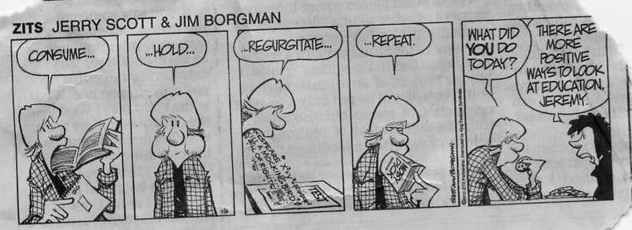
We must do things differently

Slide 51
We must do things differently
These Standards are not intended to be new names for old ways of doing business.
They are a call to take the next step. It is time for states to work together to build
on lessons learned from two decades of standards based reforms. It is time to
recognize that standards are not just promises to our children, but promises we
intend to keep.

Slide 52
Scope and Sequence
From the Common Core Tools
http://commoncoretools.files.wordpress.com/2012/03/9_11-scope-and-sequence_traditional1.pdf

Slide 53
Notes:
Here we see the progression of domains across the grade levels. Again, notice that the only domain common to all grades is Geometry. It is important to note the transitions such as number and operations in base ten to ratios and proportional relationships that occurs from 5th grade into 6th grade

Slide 54
Notes:
Each grade band has responsibility for 4 – 5 content domains. The only content domain common to all grade bands is Geometry.

Slide 55
Domains by grade

Slide 56
5. Balance between procedural fluency and conceptual understanding
Mathematical understanding and
procedural skill are equally important,
and both are assessable using
mathematical tasks of sufficient
richness.

Slide 57
From National Mathematics Panel
The curriculum must simultaneously
develop conceptual understanding, computational fluency, and problem solving skills. Debates regarding the relative importance of these aspects of mathematical knowledge are misguided.

Slide 58
Using Connections and Multiple Representations…
Mathematically proficient students can
explain correspondences between equations,
verbal descriptions, tables, and graphs or
draw diagrams of important features and
relationships, graph data, and search for
regularity or trends. Younger students might
rely on using concrete objects or pictures to
help conceptualize and solve a problem.

Slide 59
Talking???

Slide 60
6. Diverse Learners, Methods, and Assessments
Mathematics for All
Multiple Entry Points
Multiple contexts and representations

Slide 61
For ALL Students
At the same time, all students must have the opportunity to learn and meet the same high standards if they are to access the knowledge and skills necessary in their post-school lives.

Slide 62
From the Panel…
Mathematics performance and learning of groups that have traditionally been underrepresented in mathematics fields can be improved by interventions that address social, affective, and motivational factors.

Slide 63
Low Level Repetition

Slide 64
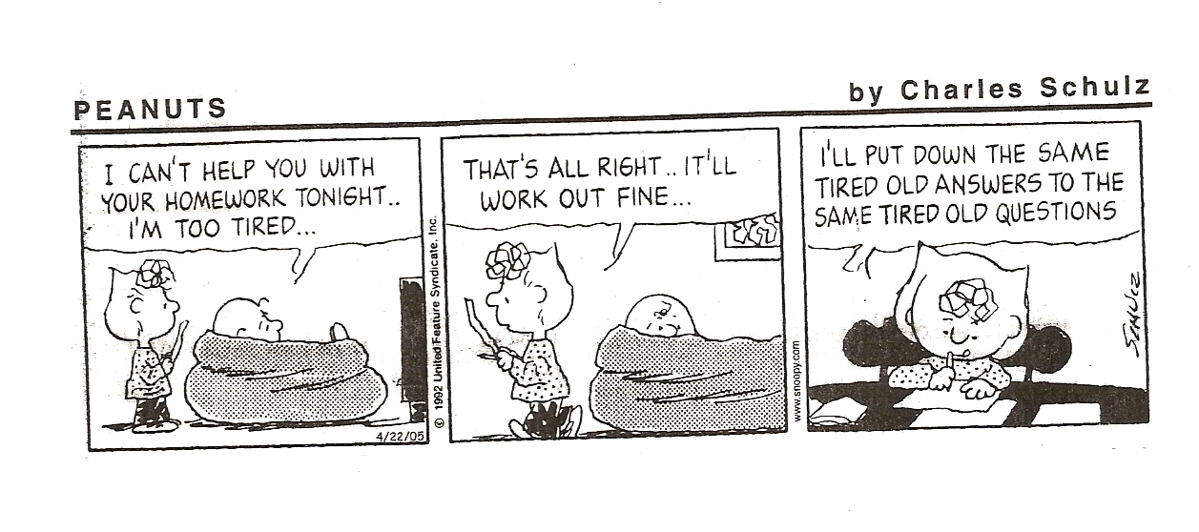
Repetition?

Slide 65
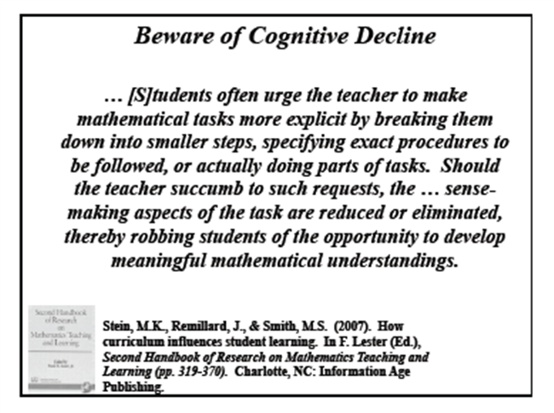
Can we help too much??

Slide 66
And diverse methods…
All-encompassing recommendations that instruction should be entirely
“student-centered” or “teacher-directed” are not supported by research. If such recommendations exist, they should be rescinded. If they are being considered, they should be avoided. High-quality research does not support the exclusive use of either approach.

Slide 67
From the Core…
These Standards do not dictate curriculum or teaching methods.

Slide 68
More From the Core…
Learning opportunities will continue to vary across schools and school systems, and educators should make every effort to meet the needs of individual students based on their current understanding.

Slide 69
Try the starburst problem
Multiple entry points
Concrete to abstract
Connections
Old or new??

Slide 70
Assessment in the Common Core
Asking a student to understand
something means asking a teacher to
assess whether the student has
understood it.
The student who can explain the rule
understands the mathematics, and may have a better chance to succeed at a less familiar task such as expanding
(a + b + c)(x + y)

Slide 71
Diverse Assessments?
Short Answer (including MC)
Extended Answer
Scaffold Questions
See triangle toothpicks
From ISBE assessment tasks

Slide 72
Similar Assessments
ISAT
NAEP questions http://nces.ed.gov/nationsreportcard/itmrlsx/landing.aspx
Dare to Compare http://nces.ed.gov/nceskids/eyk/index.asp
TIMSS
http://nces.ed.gov/timss/educators.asp

Slide 73
Common Denominators
1. Shift Happens and Need for Shift
2. Focus on Problem Solving
3. Key Concepts in Multiple Contexts
4. Quality over Quantity
5. Balance
6. Diverse Learners, Methods, and Assessments

Slide 74
The “New” Common Core Standards
Reinforce current best practices
Represent uniform and common focus
Significant in their development and shared purpose
But maybe not all that ‘new’
A cohesive collection of what we already ‘knew’

Slide 75
Common Connections
See Guide

Slide 76
Related Links
Common Core
http://faculty.wiu.edu/JR-Olsen/wiu/common-core/front.html
Research and Reports page
http://faculty.wiu.edu/JR-Olsen/wiu/research/ed-res-1.htm
ACT and PSAE
http://www.wiu.edu/users/mfrrm1/psaewebsitespPracticeMaterials.html

Slide 77
Same old tired questions?

