Slide 1
Math K-5:
Capture the Connections!
Alanna Mertens
Pat Reisdorf

Slide 2
What Is Math?
On an index card, write
First Name and Grade Level
Define/describe: Math is…
One thing you hope to learn
One thing you hope we cover
Notes:
Pre-Assessment & Self-Reflection
Bullets 3 & 4: Learning vs. Teaching

Slide 3
Objectives
Develop Awareness of CCSS and Key Shifts
Encourage self-reflection through lively discussions with colleagues
Build Knowledge of Mathematical Practice and Content Standards
Translate Knowledge into practice through high cognitive demand projects and performance assessments

Slide 4
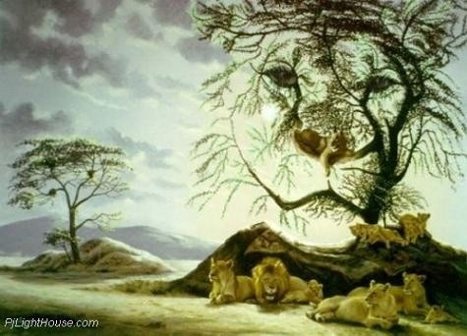
Circle of Life
Notes:
Introduce Circle of Life Activity.
“Hakuna Matata”, in Swahili, means, "There are no worries."
Consider using Hakuna Matata (Music by Elton John, Lyrics by Tim Rice) and/or Circle of Life (Music by Elton John, Lyrics by Tim Rice)
Talk about the importance of visual and real world connections in math
“Hakuna Matata”, in Swahili, means, "There are no worries."

Slide 5

Circle of Life
Put on a Number Badge
Find people to form a 0-9 circle
Organize yourselves clockwise, 0-9; decide on a group name
Ask your Zero Rep to pick up a ball of yarn for your group

Slide 6

Circle of Life
Informal Pre-Assessment
Before we start,
Has your group formed
a circle?
How do you know?
Could you show us?
Notes:
Explain process to participants.
Choose a number to multiply and complete the multiplication tables. Using the one’s digit, connect the numbers in the repeating pattern.
Note: If this is done on paper, students can make a chart. With a 10-pt circle, students can use a ruler to connect the numbers to find the pattern.
Example:
Multiply (3) by: 0 1 2 3 4 5 6 7 8 9 10
Solution: 0 3 6 9 12 15 18 21 24 27 30
One’s Digit: 0 3 6 9 2 5 8 1 4 7 0
With yarn and a circle of participants (0-9), have the Zero representative start.
Hold the ball of yarn for 0 x n. While holding a piece of the yarn, toss the ball to the 1 x n participant.
The 1 x n participant holds a piece of yarn and tosses it to the 2 x n participant.
This process continues until the yarn pattern returns to the Zero representative at 10 x n
Participants can decide whether the whole group recites the fact & solution, or if a single participant is responsible for the fact and solution.
Yarn should be held taut at ~ 3 ft from the ground.
What happens?
Suggest that groups try other numbers.
Does this pattern reappear?
Does everyone in the group get to participate? Why or why not?
Which number patterns seem to be the most interesting? Why?
Do multiples or factors of a number follow the same pattern? Why or Why not?

Slide 7

Circle Connections
Discover Math Patterns in:
Multiplication
Skip Counting
Geometry
Inc. ISBE Social-Emotional Learning Standard 2C
Notes:
(Continued from previous page)
Focus on the following CCS Standards for Mathematical Practice:
MP7: Look for and make use of structure.
MP8: Look for and express regularity in repeated reasoning.
Focus on the following CCS Math Content Standards through questions & discussion:
K.CC.2, K.CC.4, K.OA.4, K.G.4
1.OA.5, 1.OA.6, 1.G.1, 1.MD.3
2.OA.3, 2.NBT.2, 2.G.1
3.OA.9, 3.MD.1, 3.G.1, 3.G.2
4.OA.4, 4.OA.5, 4.MD.5, 4.G
5.G.3, 5.OA.2

Slide 8
Please move
(temporarily)
to a grade-alike group
Notes:
Optional, based on room configuration

Slide 9
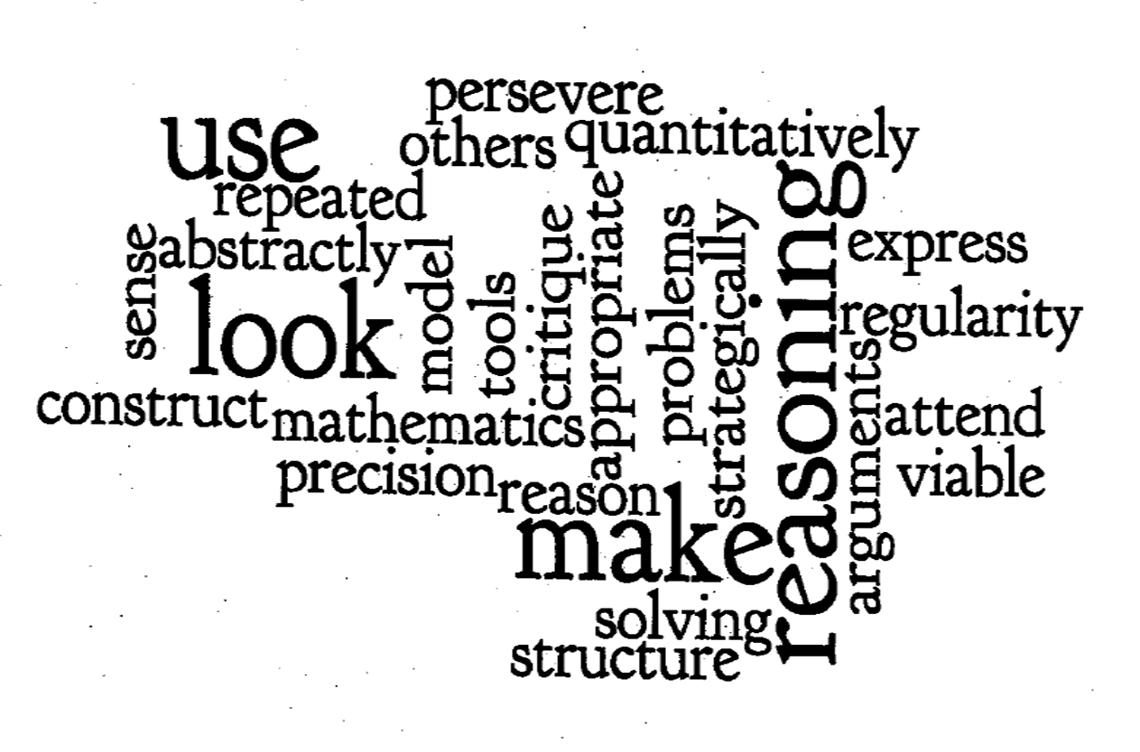
Math Practice Standards
Created using: http://www.wordle.net/
Notes:
From: http://www.wordle.net

Slide 10

Take a Closer Look:
Math Practice Standards
What is Expected of Students?
What Makes You Wonder?

Slide 11
Math Practice Standards 101
Students Are Expected To
Read…
Write…
Speak…
Listen to, and
Do Math
Notes:
Connect to
High Expectations
Actively Engaging Students
What is expected in the ELA Standards

Slide 12
Making Connections
Content Standards
  Counting & Cardinality?
    Operations & Algebraic Thinking?
    Geometry?
Practice Standards
MP7, MP8?
Others?
Notes:
Focus on the following CCS Standards for Mathematical Practice through questions:
MP7: Look for and make use of structure.
MP8: Look for and express regularity in repeated reasoning.
Focus on the following CCS Math Content Standards through questions & discussion:
K.CC.2, K.CC.4, K.OA.4, K.G.4
1.OA.5, 1.OA.6, 1.G.1, 1.MD.3
2.OA.3, 2.NBT.2, 2.G.1
3.OA.9, 3.MD.1, 3.G.1, 3.G.2
4.OA.4, 4.OA.5, 4.MD.5, 4.G
5.G.3, 5.OA.2

Slide 13

Connect to Learning
Per Standards for Grade ___, how could you assess student learning?
Work with grade-alike partners
Report on chart paper
Large group reports
Notes:
Include grade levels & identified standards

Slide 14
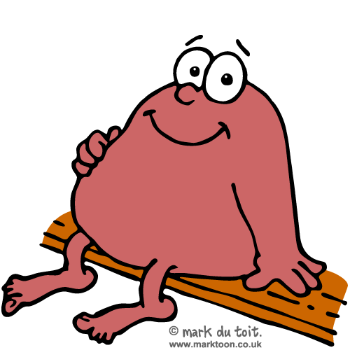
Take Time to Breathe…
It’s time to transition
Graphic by Mark duToit, used w/permission: http://www.marktoon.co.uk

Slide 15
From Circles to Squares
Fold a red square on a diagonal & cut
What are all the ways to put the two shapes together?
Notes:
Post a piece of Chart Paper labeled “Geometry Words”.
Add Square, Triangle, Diagonal
Ask teachers to put two shapes together and discuss.

Slide 16
Guess My Rule
These fit my rule
These don’t fit my rule
Notes:
Rule:
Sides that touch must be the same length and match exactly.

Slide 17
Four Triangle Problem
Cut a yellow square on the diagonal.
Using two red & two yellow triangles, create shapes that follow the rule.
Tape your shapes together.
Find all possible shapes using four triangles. (Consider only congruence, not color or position)
Source: “The Four Triangle Problem” Marilyn Burns’ Replacement Unit: Math By All Means by Cheryl Rectanus
(Math Solutions Publications, 1994), pp. 16-25
Notes:
Source: The Four Triangle Problem, Marilyn Burns Replacement Unit: Math By All Means, by Cheryl Rectanus, Math Solutions Publications, 1994, pp. 16-25
Rule: Sides that touch must share a common edge
NOTE: Identical shapes can be different colors.
Visit groups and help them find all 14 possible shapes.

Slide 18
Classify and Justify
Sort your shapes
Be ready to explain your thinking
Notes:
Participants can make posters of their sorts then present their posters and discuss reason for sorts.
Facilitator should highlight different strategies for sorting and ask for justification.

Slide 19
More Connections
What Content Standard(s) is/are addressed?
What would this lesson look like at your grade level?
Notes:
Have teachers take out K-5 Matrix of Cluster Headings and their Content Standards.
Bring attention to the bold coding on the Matrix.
Focus in on the geometry standards.
Analyze the Lesson with the grade level content standard in mind.
Does this lesson focus on the standard(s)? Which grade level geometry standard?
What would this lesson look like for the grade you teach?

Slide 20

Key Shifts
  Fluency
  Coherence
  Focus
  Deep Understanding
  Application
  Dual Intensity
Notes:
Pick a domain heading and trace the flow of learning across the grade levels.
What do you notice?
What is most surprising? No work with fractions until third grade?
FOCUS? Teachers are not asked to teach everything at every grade level.
We have the time to teach for deep understanding and application.

Slide 21
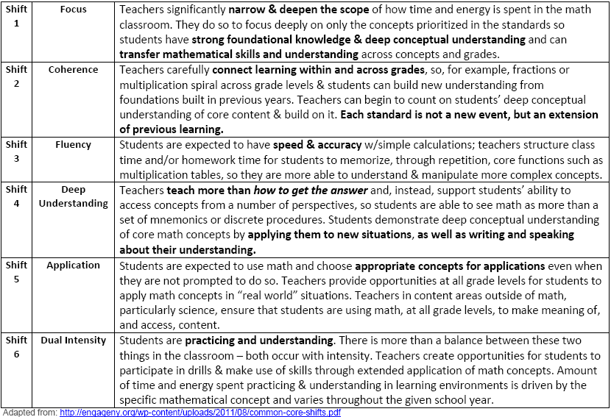
Dual Intensity
Notes:
Ask teachers to read the document: Key Shifts in CCSS Mathematics from engageNY
Direct teachers to note important aspects.
Discuss shifts that happen in the Progressions: Coherence
Discuss the shift needed to make the Mathematical Practices a reality that will result in Deeper Understanding through Focus in lessons.
Discuss expected Fluencies and balance between practice and deep understanding that is discussed in Dual Intensity

Slide 22

Birthdays and a Break
Make a written prediction of
Most Popular Birth Month
Print name and birthday on card
Estimate accurate location
Refine estimate, based on peer
posts; post your card online
Take a 10- min break
Notes:
Clothesline is provided, with a marked indication of the halfway point of the year, July 2.

Slide 23

Birthdays?
Do We Have Any Birthdays Today?
Notes:
If so, use the Special Group Message on the next slide

Slide 24

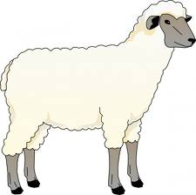
Special Group Message
( x 2)
Notes:
If anyone in the room has a birthday today, use this slide.
Review symbols w/participants
Hippo Birdie Two Ewes (twice)
Hippo Birdie Dear (insert name)
Hippo Birdie Two Ewes

Slide 25
Most Popular Birthday Month
Did predictions match data?
Did prior knowledge influence your predictions?
Notes:
Group discussion

Slide 26
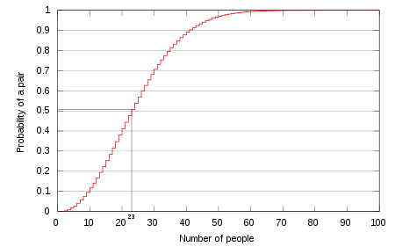
Same-Birthday Probability
Source: http://en.wikipedia.org/wiki/Birthday_problem

Slide 27
Birthday Probabilities
Chances of Same-Day Birthdays:
100% probability with 366 people
99% probability with 57 people
50% probability with 23 people.
Source: http://en.wikipedia.org/wiki/Birthday_problem

Slide 28



Fraction Fears?
Maybe Jill & Tim can help
http://www.youtube.com/watch?v=lMLZexFH50c
Notes:
Discuss shift in teaching fractions…Let go & focus!
Before break we talked about focus & coherence as Key Shifts.
Now we will look at fractions as an example of Focus and Coherence.

Slide 29
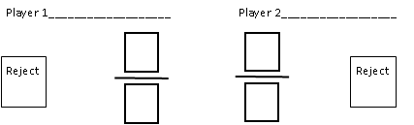
Roll A Fraction
Fold a piece of paper in half vertically.
Draw a fraction with a box for the numerator, a box for the denominator and a reject box for each player.
Adapted from “The Comparing Game” Marilyn Burns’ Teaching Arithmetic: Lessons for Extending Fractions, Grade 5 (Math Solutions Publications, 2003), pp. 56–63, 145–152.
Notes:
This activity has been adapted from “The Comparing Game” Marilyn Burns’ Teaching Arithmetic: Lessons for Extending Fractions, Grade 5 (Math Solutions Publications, 2003), pp. 56–63, 145–152.
Ask participants to find a shoulder partner.
Distribute one sheet of blank paper and 1 die per pair.

Slide 30
Start Rolling!
Take turns rolling a die and placing the rolled number in a box on your side of the recording sheet.
Once the boxes are filled, decide which player built the greatest fraction.
Play the game several times. What do you notice?
Notes:
Participants play at least 4 rounds.

Slide 31

Reflect and Connect
Write your strategy for winning.
What Practice Standard(s) was/were addressed?
Notes:
Have teachers share two strategies and compare.
Ask what strategies kids might have.
Discuss the advantage of engaging students in activities that inspire conversations, arguments discourse in math.
Partner work means all students are talking.
MP3

Slide 32
Differentiate
Look at the Content Standards for your Grade Level.
How could you change the game to align to a standard at your grade level?
Share ideas at your table.
Notes:
Look at the content standard for Number & Operations - Fractions in grades 3,4,5.
Look at the content standards for K,1,2 for counting, adding and subtracting.
How could you change the game to align to the standards at your grade level?
This activity addresses 4.NF.2
Highlight that games like this one could be used to move towards expected fluencies.
Examples of other games with dice:
K- Roll a dice to start and end counting
1st- Adding one digit and two digit numbers
2^{nd-} Add and compare whole numbers
3rd- Compare fractions using the recommended denominators of 2,3,4,6,8
4th – Add and compare fractions
5th- Multiply and compare fractions
All- use sticker dots to create the exact practice each child needs

Slide 33
What’s Next?
Common Assessments
Common Core State Standards are critical, but it is just the first step
Common assessments aligned to the Common Core will help ensure the new standards truly reach every classroom
http://www.parcconline.org
Notes:
TALKING POINTS
While the Common Core State Standards are a critical first step, they alone will not bring about the instructional changes necessary to improve student achievement and attainment. Creating common assessments grounded in common standards is the logical next step and will ensure the new standards truly reach every classroom
I think we will all agree that the current system is broken. Every state develops their own assessments and for that reasons our nation’s assessments:
Are of varying quality and rigor and rarely point toward College- and Career-Readiness.
Do not provide meaningful, real-time data for our educators, parents and policymakers
Cannot be compared from state to state, ensuring that students in Mass. And Miss. are receiving the same foundation
Next generation assessments will:
Provide a more complete picture of student performance against college- and career-ready expectations
Use current and future technologies to provide a meaningful assessment and useful data
Mitigate Challenges associated with mobility—which is a major challenge in education
U.S Department of Education set aside $350 million of Race to the Top funding for awards to consortia of states to design and develop common K-12 assessment systems aligned to common, college- and career-ready standards. In Sept. 2010, the U.S. Department of Education awarded grants to the Partnership for Assessment of Readiness for College and Careers (PARCC) and Smarter Balanced Assessment Consortium (SBAC)

Slide 34




PARCC Assessment Design
English Language Arts/Literacy and Mathematics, Grades 3-11
Optional Assessments/Flexible Administration
Diagnostic Assessment
Early indicator of student knowledge and skills to inform instruction, supports, and PD
Mid-Year Assessment
Performance-based
Emphasis on hard-to-measure standards
Potentially summative
Performance-Based
Assessment (PBA)
Extended tasks
Applications of concepts and skills
End-of-Year
Assessment
Innovative, computer-based items
ELA - Speaking And Listening
Assessment
Locally scored
Non-summative, required
Summative,
Required assessment
Interim, optional assessment
http://www.parcconline.org
Notes:
TALKING POINTS
Graphic depiction of the assessment system. The system includes a suite of assessments and tools that, taken together, provide a more complete picture of student mastery of standards and progress throughout the year than is currently available on state assessments.
Considerations Leading to 2 optional assessments:
The cost of the assessments
Flexibility on when to administer the optional assessments
The amount of testing time needed to administer the assessments
Possible disruption to school schedules caused by through-course assessment preparation and administration
Constraints the distributed design might have on the flexibility of state and local educators to sequence instruction of the CCSS and to implement their own benchmark and formative assessment initiatives
The PARCC assessment system will:
Reflect the sophisticated knowledge and skills found in the English and math Common Core State Standards
Include a mix of item types (e.g., short answer, richer multiple choice, longer open response, performance-based)
Make significant use of technology
Include testing at key points throughout the year to give teachers, parents and students better information about whether students are on track or need additional support in particular areas
Taken together, the PARCC assessment components comprise a comprehensive system of assessments that will provide timely information to teachers throughout the year, and provide students with meaningful information about their progress toward college and career readiness

Slide 35
PARCC Timeline
SY 2012-13
First year pilot/field testing and related research and data collection
SY 2013-14
Second year pilot/field testing and related research and data collection
SY 2014-15
Full administration of PARCC assessments
Summer 2015
Set achievement levels, including college-ready performance levels
SY 2010-11
Launch and design phase
SY 2011-12
Development begins
http://www.parcconline.org

Slide 36

Overwhelmed?
It’s Okay to Ask for Help
http://www.youtube.com/watch?v=YoTIaRyGzac
Graphic by Mark duToit used w/permission: http://www.marktoon.co.uk/

Slide 37
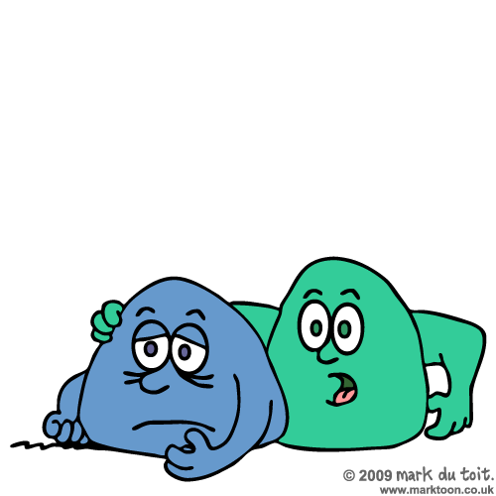
Help is Available
Grants & Awards
Recommended Resources
Graphic by Mark duToit, used w/permission: http://www.marktoon.co.uk
Notes:
Discuss & highlight:
Grants and Awards for Math Teachers
(2) Recommended Math Resources K-5

Slide 38
Reflections

Slide 39
Think About…Talk About
How you felt about Math in
Elementary and Middle School
High School and College
How you responded to
“What is Math?”
Notes:
Summary will be added

Slide 40
What is Math?
Range of responses?!?
Notes:
More will be added

Slide 41

View of a Child
Grace P, 8 yrs-old,
was asked by her Teacher,
“What did you learn
this year in Math?”

Slide 42
Her Response:
“I learned that math is not just numbers. It is LIFE.
The reason I say that is because math can be made from ANYTHING – art, music, clothes, ice cream, even the ceiling.
I could go on forever.”

Slide 43
“Math is also thinking out things that confuse you.
We NEED math.
Without decimals, everybody would go bankrupt!”

Slide 44
“I learned that it doesn’t matter how old you are, or what grade you are in, you can learn ANYTHING
if you really put your mind to it.
If math is taught right,
it is fun and easy to remember.”
By Grace P, June 8, 1988
“
Notes:
Comments: How important a teacher is in the life of a child
(More specific detail will be added as of June 19)

Slide 45


Feedback and Thanks!
Please Give Yourselves a Round of

Slide 46

We Hope You’ve
Captured the Connections!
Alanna Mertens
ALMertens@cps.k12.il.us
Pat Reisdorf
preisdor@kidsroe.org

