Slide 1
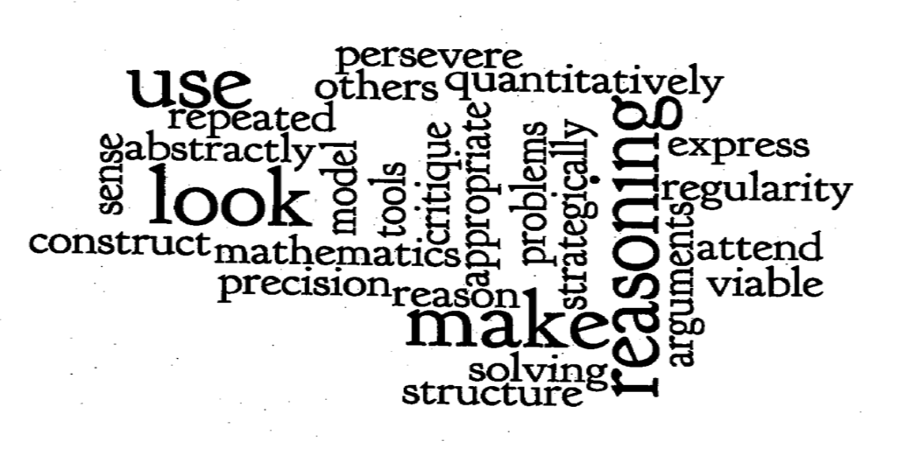
Going Deeper with Content and Practice
Alanna Mertens
ISBE Math Content Area Specialist almertens@cps.edu
Notes:
3. Construct viable arguments and critique the reasoning of others.
Mathematically proficient students understand and use stated assumptions, definitions, and previously established results in constructing arguments. They make conjectures and build a logical progression of statements to explore the truth of their conjectures. They are able to analyze situations by breaking them into cases, and can recognize and use counterexamples. They justify their conclusions, communicate them to others, and respond to the arguments of others. They reason inductively about data, making plausible arguments that take into account the context from which the data arose. Mathematically proficient students are also able to compare the effectiveness of two plausible arguments, distinguish correct logic or reasoning from that which is flawed, and—if there is a flaw in an argument—explain what it is. Elementary students can construct arguments using concrete referents such as objects, drawings, diagrams, and actions. Such arguments can make sense and be correct, even though they are not generalized or made formal until later grades. Later, students learn to determine domains to which an argument applies. Students at all grades can listen or read the arguments of others, decide whether they make sense, and ask useful questions to clarify or improve the arguments.

Slide 2
Objectives
To develop strategies to incorporate the Standards for Mathematical Practice.
To explore the K-5 content shifts required by the Common Core State Standards for Mathematics.
To experience a math activity that blends content and practice standards.
Notes:
Review Objectives.

Slide 3
Why can’t we be friends?
What does good listening look like?
What does productive group work look like?
Notes:
Facilitor:
Say, “We will be doing some math together today so we need to set some norms for our session.”
Pose the questions and chart the answers. Post prominently and refer to Norms chart throughout.

Slide 4
Standards for Mathematical Practice
What do you know about the Standards for Mathematical Practice?
The practices are the same for all K-12 students.
They define what a “mathematical proficient student” should be able to do.
Take a moment to glance over the practice standards.
Notes:
Discuss what teachers know of Math Practices.
Distribute the Standards for Mathematical Practice
Have them read SMP1- 3
Model Think INK Pair share strategy for discussion of the Standards.
Lead a “Think- Ink – Pair –Share” Discussion
Think--First ask participants to consider the questions
Ink-- Then write their thoughts on paper
Pair—Then share with a shoulder partner
Share-Then share with the larger group

Slide 5
Standard for Mathematical Practice 3
Read Practice 3
Make note of some important ideas
Be ready to discuss your vision of a great math class that incorporates Mathematical Practice Standard 3.
What are the students doing?
What is the teacher doing?
Notes:
Discuss what teachers know of Math Practices.
Distribute the Standards for Mathematical Practice
Have them read SMP1- 3
Model Think INK Pair share strategy for discussion of the Standards.
Lead a “Think- Ink – Pair –Share” Discussion
Think--First ask participants to consider the questions
Ink-- Then write their thoughts on paper
Pair—Then share with a shoulder partner
Share-Then share with the larger group

Slide 6
Envision a Common Core Math Class
What has to happen before we can have students exhibit Mathematical Practice Standard 3?
Notes:
Introduce the video.
This is an 8 minute video of a teacher building a discourse based classroom environment.
The blue sentence on the slide is a link to the video.
It’s a good idea to pre-load the video to be sure it runs smoothly
You will need speakers.
http://www.edutopia.org/math-social-activity-cooperative-learning-video?page=2

Slide 7
Illinois≠Alaska
How does what Mr. Optiz is doing in Alaska relate to Practice Standard 3 here in Illinois?
Notes:
Discuss being intentional about creating a class where Math Practices can happen.
Once we have the students engaging in discourse next we need content standards!

Slide 8
Instructional Shifts
Fluency
Coherence
Focus
Deep Understanding
Application
Dual Intensity
Notes:
www.engageNY.org has a nice shift handout on all the shifts.
Think about focus. As teachers of the common core we need to get to deeper understanding and we cannot do that with our current mile wide and inch deep curriculum.
Focus: Teachers use the power of the eraser and significantly narrow and deepen the scope of how time and energy is
spent in the math classroom. They do so in order to focus deeply on only the concepts that are prioritized in the
standards so that students reach strong foundational knowledge and deep conceptual understanding and are able
to transfer mathematical skills and understanding across concepts and grades.

Slide 9
Coherence and Focus
Pick a domain heading and trace the flow of learning across the grade levels.
What do you notice?
What is most surprising?
Notes:
Direct teachers to look at matrix of K-5 clusters
Ask:
Pick a domain heading and trace the flow of learning across the grade levels.
What do you notice?
Share ideas…Bring attention to fractions
An optional video about fractions is below.
http://www.youtube.com/watch?v=lMLZexFH50c
Now we are going to look at fractions as an example of fluency, focus and coherence

Slide 10
Fractions, Fluency and Fun
To build fluency we should find ways for students to practice from repeated use through motivational activities…
--Joan Barrett
Notes:
Ask teachers to find fluency in their content standards.
This is not a building fractions lesson this is for fluency and for MP3

Slide 11
4.NF.2
Compare two fractions with different numerators and different denominators, e.g., by creating common denominators or numerators, or by comparing to a benchmark fraction such as 1/2. Recognize that comparisons are valid only when the two fractions refer to the same whole. Record the results of comparisons with symbols >, =, or <, and justify the conclusions, e.g., by using a visual fraction model.

Slide 12
Roll A Fraction
Fold a piece of paper in half the long way.
Draw a fraction with a box for the numerator, a box for the denominator and a reject box for each player.
Notes:
Ask participants to find a shoulder partner
Distribute paper and 1 die per pair

Slide 13
Start Rolling!
Take turns rolling a die and placing the rolled number in a box on your side of the recording sheet.
Once the boxes are filled, decide which player built the greatest fraction.
Place the appropriate symbol between the fractions.
Play the game several times. What do you notice?
Notes:
Participants should play at least 4 rounds.

Slide 14
Reflect and Connect
Write your strategy for winning.
How did you decide which fraction was greater?
Who could play this game?
What Mathematical Practice Standard(s) were used?
Notes:
Discuss the advantage of having a discourse around math.
Partner work means all kids are talking not just a few talking and following directions.
MP3

Slide 15
Differentiate the Game
Look at the content standard for fractions in grades 3,4,5.
Look at the content standards for K,1,2 for counting, adding and subtracting.
How could you change the game to align to a content standard at your grade level?

Slide 16
Share and Compare
K - Roll a dice to start and end counting
1st - Adding one digit and two digit numbers
2nd - Add and compare whole numbers
3rd - Compare fractions
4th – Add and compare fractions
5th - Multiply and compare fractions
All - use sticker dots to create the exact practice each child needs
Notes:
Other ideas
Some ways to adapt the game generate all possible fractions that could be made.
Kids Could put on number line between zero

Slide 17
Resources
The Illinois State Board of Education
Content Area Specialist are here to help!
http://isbe.net/
Alanna Mertens
almertens@cps.edu

Slide 18
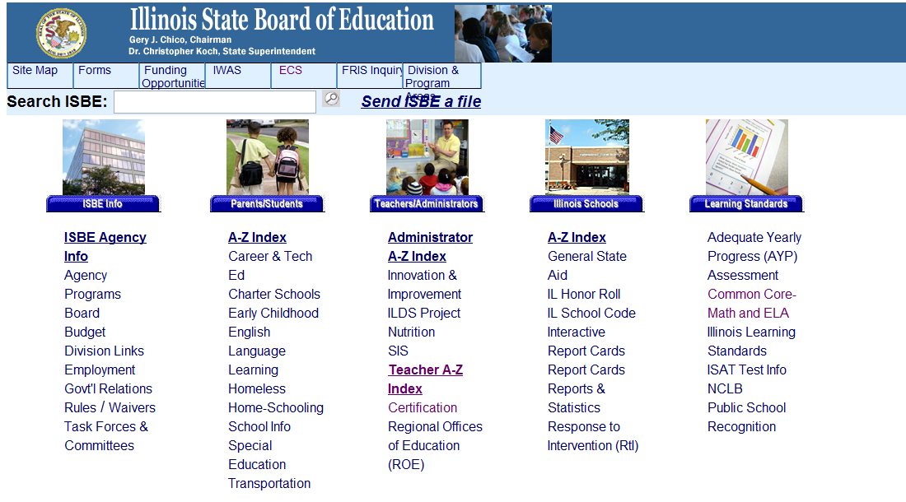
Notes:
Show participants link to resources.

