Slide 1
Common Core English Language Arts Standards K-12
Prepares students for college and careers
Research and evidence based
Aligned with college and work expectations
Rigorous
Internationally benchmarked
Structured around the four strands; reading, writing, speaking and listening, and language grades K-12
Provides content area literacy 6-12
National Governors Association/Chief State School Officers (2010)
Notes:
The purpose of creating the Common Core English Language Arts Standards K-12 was to prepare students to be college and career ready by the end of high school. As mentioned in the introduction of the Common Core document (2010) the Standards are “research and evidence based, aligned with college and work expectations, rigorous, and internationally benchmarked.” The focus kindergarten through grade twelve encompasses standards in reading, writing, speaking, listening and language. This document is built on earlier work from The Council of Chief State School Officers and the National Governors Association. The standards focus on content area literacy as well but were written to supplement not replace content area standards grades six through twelve for history, science, and technical subjects. In order to be literate in the twenty-first century students will need to be attentive and critical readers of both print and digital information.

Slide 2
College and Career Ready Students
Establish independence
Acquire a strong content knowledge base
Adapt communication to audience, task, purpose or discipline
Comprehend, critique and question
Cite and evaluate evidence
Use technology and digital media thoughtfully
Understand other perspectives and cultures
National Governors Association/Chief State School Officers (2010)
Notes:
The definition of career and college ready students is listed in the Common Core document. Students who are college and career ready in reading, writing, speaking, listening and language establish independence, have a strong content knowledge base, and adapt communication to specific audience, task, purpose and discipline. These students comprehend, critique and question what they consume. They value evidence and cite evidence while communicating. In addition, students evaluate others use of evidence. College and career ready students use technology and digital media thoughtfully and understand and appreciate other perspectives and cultures.

Slide 3
Common Core English Language Arts Standards K-12
  Common Core Anchor Standards and grade level standards
Reading, writing, speaking and listening, and language are interrelated
Research and media skills are embedded
Responsibility for literacy instruction shared by English instructors and content area teachers
National Governors Association/Chief State School Officers (2010)
Notes:
The Common Core Anchor Standards are the over-arching standards that need to be met while the grade specific standards provide more detail. Each grade level standard builds on the previous grade level standard adding nuances relating to the overarching Anchor Standards. The Standards are set up in a manner to allow teachers to use the information to create lessons which are not mandated in the document. In fact, since Illinois is a locally controlled state, one of the goals of the English Language Arts Content Specialist team is to help teachers make connections from the standards to practice not to add curriculum. Reading, writing, speaking, listening and language are interrelated throughout the standards, and media skills relating to consuming and producing digital literacy are embedded throughout the standards as well. Responsibility for literacy instruction is shared between both English Language Arts instructors and content area teachers. Part of the reason for this shared approach to fostering literacy is that informational texts for college and career training are increasingly complex.

Slide 4
Structure of Common Core English Language Arts Standards
Sections
  K-5 ELA , 6-12 ELA , 6-12 history/social studies, science and technical subjects
Strands
  Reading, writing, speaking and listening, language
Text complexity
Writing types and skills
Connection of reading and writing
Collaborative discussion
Conventions and vocabulary
Appendices
National Governors Association/Chief State School Officers (2010)
Notes:
Each section is divided into strands. In K-5 and 6-12 the strands are reading, writing, speaking and listening and language, and 6-12 content area focus on the reading and writing strands. In reading and writing there are ten standards each. In Speaking and listening there are six standards and there are six standards for language. Standard 10 depicts gradualness of text complexity as students move one grade level to the next starting with beginning reading and ending with college and career readiness. Writing types and skills are defined including research skills. Standard 9 focuses on the connection of reading and writing. When speaking and listening students must be able to collaborate with peers, integrate information and convey meaning. The language standards focus on not only the conventions of spoken and written English but on learning new vocabulary including academic vocabulary. Appendix A includes explanation of text complexity, defines key writing types, research that supports key elements and a glossary of terms. Appendix B provides text exemplars, sample performance tasks cross content nonfiction and information text. And appendix C provides samples of adequate writing at grade levels.

Slide 5
What is Not Covered by the Standards?
How teachers should implement
All that can be taught
Advanced work
Interventions or materials needed for students below grade level
Defined support for English language learners and students with special needs
National Governors Association/Chief State School Officers (2010)
Notes:
Educators have many choices in deciding how to implement the standards. The Standards do not tell teachers how to teach or implement the Standards. Rather, the standards designate what students should know and be able to do. The standards are not all that can be taught. The Standards do not define advanced work for students who have achieved the Standards for each grade level. The standards also do not define the interventions or materials to use. Additionally, the Standards do not define the scaffolding needed for English Language Learners and students with special needs.

Slide 6

Key Ideas
Text complexity
Balance of informational and narrative text
Content area literacy
Writing to argue or explain
Academic discussion
Academic vocabulary
Integration of research and media skills
National Governors Association/Chief State School Officers (2010)
Notes:
When aligning English Language Arts Common Core Standards to current classroom instruction and materials, consider key points in reading, writing, speaking and listening, language, and media and technology.

Slide 7
Text Complexity
Staircase of complexity
Each grade level, another step of growth
More time for close and careful reading
Appropriate and necessary scaffolding and supports for students reading below grade level
Notes:
As students enter each grade level the texts must be increasingly complex to prepare students for the demands of college and careers. Educators are responsible for making sure that students are exposed to grade level text complexity regardless of their reading ability.
Students read grade appropriate text. Teachers create more time in the curriculum for this close and careful reading, and provide the necessary scaffolding. Teaching students to closely analyze texts and searching for evidence should verify claims and conclusions.
Students focus on shorter chunks of text with close attention. Rereading and looking for evidence to support conclusions draw from the text is critical to becoming an effective reader. Again, this is a development of higher order thinking and questioning, and synthesizing the information to create a student’s own opinions.

Slide 8
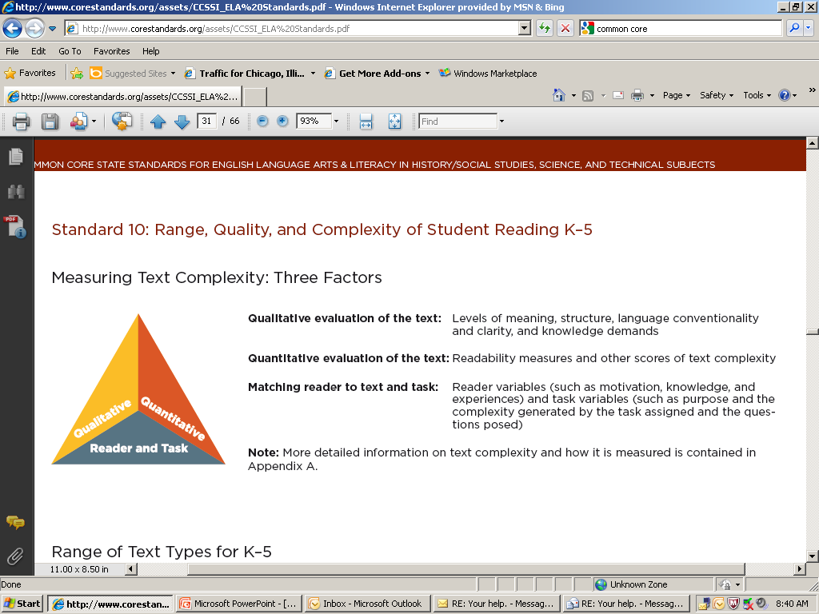
Notes:
See page 31 of the Common Core document.
“Qualitative evaluation of the text- Levels of meaning, structure, language conventionality and clarity and knowledge demands
Quantitative evaluation of the text- Readability measures and other scores of text complexity
Matching reader to text and task- Reader variables such as motivation, knowledge, and experiences, and task variables such as purpose and complexity generated by the task assigned and the questions posed.”
Due to the multiple factors associated with text complexity be cautious of any vendor trying to sell a device for deciding text complexity.

Slide 9

Balance of Informational and Narrative Text
Distribution of informational passages by grade according to 2009 NAEP Reading Framework
50% K-5
55% by grade 8
70% by grade 12
National Governors Association/Chief State School Officers (2010)
Notes:
On page 5 of the Common Core document the authors talk about the balance needed between reading literary and informational text in order to match with the NAEP assessment framework.
When planning lessons teacher use a balance of informational and literary texts. Since half of what students read is informational, classroom curriculum in English Language Arts includes science, social studies, and other content area information. To prepare for careers and college more informational texts will be read by students. Often informational text is not developed as extensively as narrative in the primary grades. The key is to support informational as well as literary text.

Slide 10
Content Area Literacy
Content area teachers emphasize reading and writing in planning and delivery
Content area teachers and literacy teachers share responsibility of students’ literacy development
Notes:
Literacy is a focus within content areas in grades 6-12. Content area instructors prepare lessons and deliver instruction fostering use of domain-specific texts and writing information and arguments. Content area teachers and English Language Arts instructors share the responsibility of students’ literacy development.

Slide 11

Writing to Argue or Explain
Writing to sources and writing an argument based on evidence and conveying complex information should be part of instruction.
Writing prompts should be tied to texts.
Students should be writing arguments/taking stances and using evidence from sources to support their positions.
Notes:
In additional to being able to write about a real or imagined experience,students need to be able to write logical arguments based on evidence and know how to research, analyze and present new information. In grades 9-12 the focus is primarily on writing information and arguments through use of evidence. Writing prompts should be tied to texts and writing for research should not be a once a year event. Short research projects should be included in every unit of study and occur throughout the year with a particular focus on written arguments that respond to ideas, events, facts, and arguments presented in texts.
David Coleman (2011), one author of the Common Core ELA Standards, gave an writing example in his video. He explained a typical writing prompt for students after reading Martin Luther King’s “Letter from a Birmingham Jail” might ask students to discuss the idea of freedom and what it means to her/him. However, a “writing to sources” assignment would be: What does freedom mean to the author? How does the author define freedom? In this assignment students cannot answer the question without having read and analyzed the text and used evidence from it to support his/her conclusion.

Slide 12
Academic Discussion
Teachers will….
Foster rich discussions dependent on common text
Focus on higher- level questioning
Focus on connections to text
Develop habits for making arguments in discussion and writing
Notes:
Students need opportunities to participate in collaborative conversations that enable them to understand and problem-solve.
Teachers will train students how to connect to other texts, synthesize information and develop higher level thinking skills. Teachers structure questions so that students will have read and analyzed the texts in order to answer. This information may be interpreted as how to argue initially, but students need practice in supporting their point of view.
Students will develop habits for making evidentiary arguments both in conversation, as well as in writing to assess comprehension of a text.

Slide 13
Academic Vocabulary
Tier One Words- Consist of basic words and rarely require instructional attention in school and highly frequent in life: clock, baby, ball, happy, walk, run.
Tier Two Words - High frequency use for mature language users and found across a variety of knowledge domains: coincidence, absurd, industrious, fortunate.
Tier Three Words - Low frequency use and limited to specific knowledge domains: isotope, lathe, peninsula, refinery, etc. Best learned when teaching specific content lessons such as geography, science.
Beck, I.L., McKeown, M.G., & Kucan, L. (2002).
Notes:
Students learn vocabulary through reading, conversations and direct instruction. Formal academic language is required to be successful in college and in careers. The ideas is to have a working vocabulary to access grade-level, complex texts with a focus on pivotal, commonly found words. Teachers will empower students with strategies to access new vocabulary in both writing and reading. Each content area has domain specific vocabulary and must be taught explicitly. On page 33 of Appendix A of the Common Core document tier words are explained.

Slide 14
Integration of Research and Media Skills
Critically read print and digital media
Critically consume and synthesize research
Know uses of technology to fit purpose
National Governors Association/Chief State School Officers (2010)
Notes:
Finally, research and media skills are integrated throughout the English Language Arts Standards. Critically consuming,
compiling, understanding, synthesizing and producing research are skills needed by students at the present time. Technology is used by students to enhance their literacy. The Common Core authors explain that students currently search for information using technology and can synthesize that new information with what they learn offline. Students also know what uses of technology fit their purposes to convey information and know the strengths and disadvantages of using a particular form of digital media.
A note in the Common Core Standards document regarding range and content of student speaking an listening reads:
“…New technologies have broadened and expanded the role that speaking and listening play in acquiring and sharing knowledge and have tightened their link to other forms of communication. Digital texts confront students with the potential for continually updated content and dynamically changing combinations of words, graphics, images, hyperlinks, and embedded video and audio.”

Slide 15
Projected Outcomes
Presentations throughout state
Standard strategy suggestions
Formative assessment suggestions
Common Core Clearinghouse
  www.isbe.net/common_core/default.htm
Notes:
This is an update of presentations and products the English Language Arts Specialists are creating and posting on the Illinois State Board of Education site. Resources will be added periodically. The following slides depict samples of the work from the English Language Arts Specialist Team.

Slide 16
ELA Coding System
Each strand is abbreviated in the standards
Grades K-5
Grades 6-12
Reading Foundational (RF)
Reading Literature (RL)
Reading for Informational (RI)
Writing (W)
Speaking and Listening (SL)
Language (L)
Reading Literature (RL)
Reading Informational (RI)
Reading for History (RH)
Reading Standards for Science and Technical Subjects (RST)
Writing for History, Science and Technical Subjects.(WHST)
Speaking and Listening (SL)
Language (L)

Slide 17
Reading Strand Grade Level Standard
There are 3 parts to each coded standard
RL.6.2
READING LITERATURE
The first section of the code represents one of the strands, in this case, Reading Literature
GRADE 6
This section represents the grade level for the standard, in this case, grade six
STANDARD 2
The third section represents the number for the standard itself, in this case, standard 2
Notes:
Explain the common core coding:
RL- reading for literature
RI-reading for information
RF-reading foundations
W-writing
SL-speaking and listening
L-language
Also, explain that in RL2.6 that would mean Reading for Literature strand, grade 2, and standard 6.

Slide 18

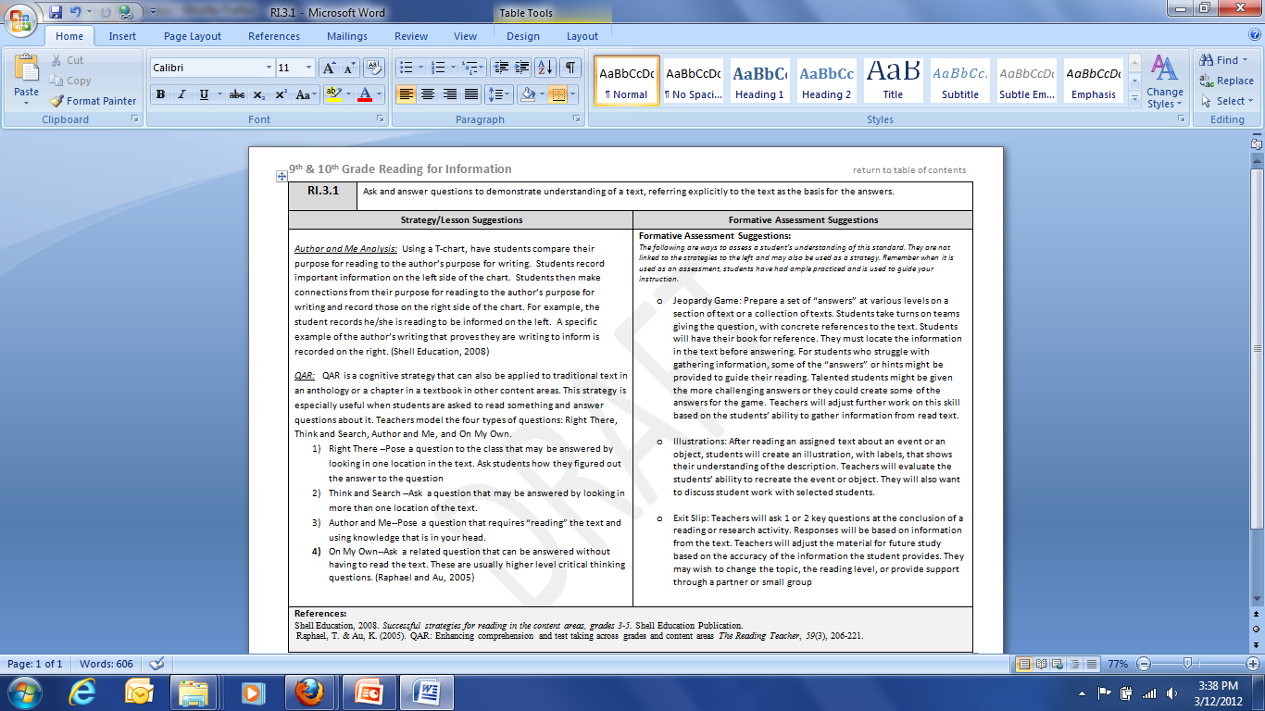

Slide 19
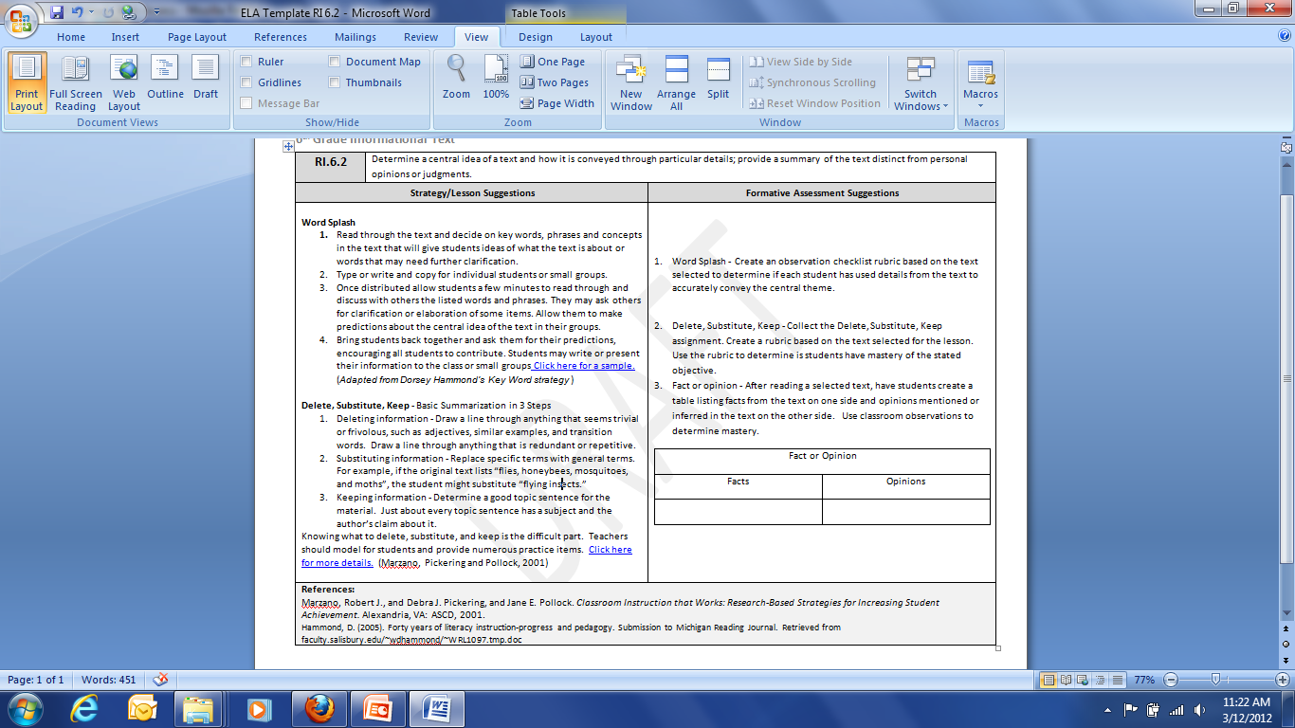

Slide 20
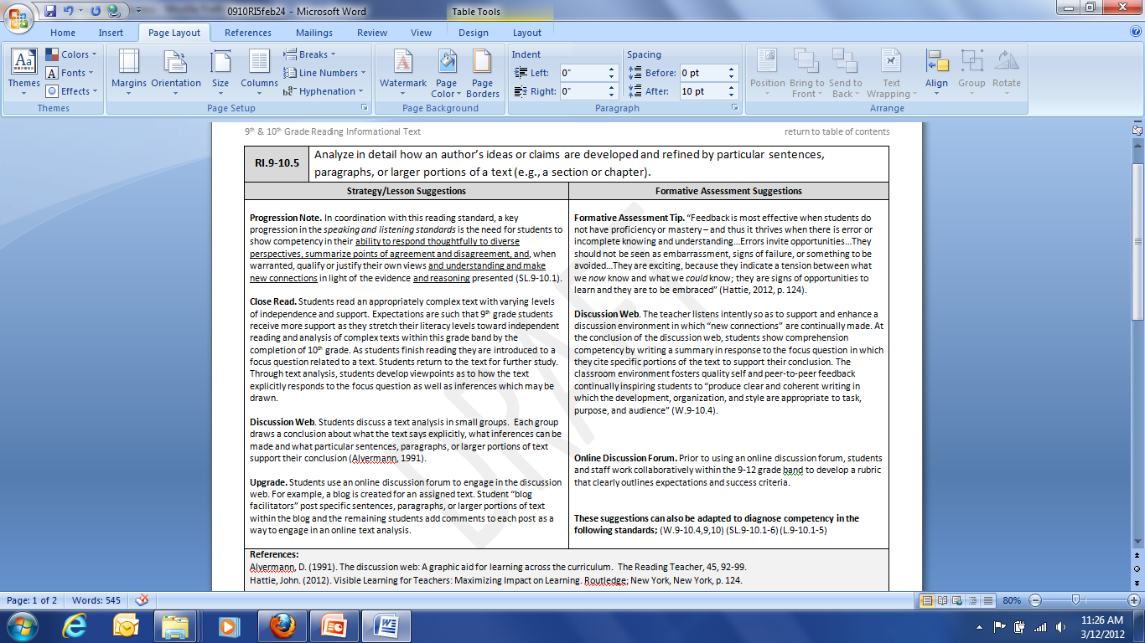

Slide 21
Resources
www.writingfix.com
This site includes 6 Traits of Writing, writing prompts, sample lessons, anchor text suggestions, and interactive components.
http://www.literacyleader.com/
Teachers and learners will find resources and can share best practices for teaching students to effectively read, write, listen, speak, and think.

Slide 22
Resources
http://www.superteacherworksheets.com/full-ela.html
This site includes sample reading texts and printable poems for different grade levels along with practice sheets for grammar.
http://betterlesson.com/
This site has cross curricular lesson plans for free. Registration is required to access parts of the site.
http://www.learner.org/jnorth/tm/InstrucStrats_40Best.html
Journey North’s lessons and activities provide teachers with resources engaging students in real-world investigations and incorporating content area reading strategies.

Slide 23
Resources
http://freeology.com/graphicorgs/page/12/
Nearly 100 free, printable graphic organizers for a wide variety of topics can be accessed.
http://www.washingtonco.k12.nc.us/siteimages/images/uploads/Graphic%20Organizers%20for%20Reading.pdf *
Graphic organizers can be accessed that connect to specific reading skills with a focus on informational strategies in upper elementary and middle school.
Notes:
Many websites house graphic organizers. However, this particular site includes thinking skills associated with the organizers. An example follows in the next two screen shots.

Slide 24
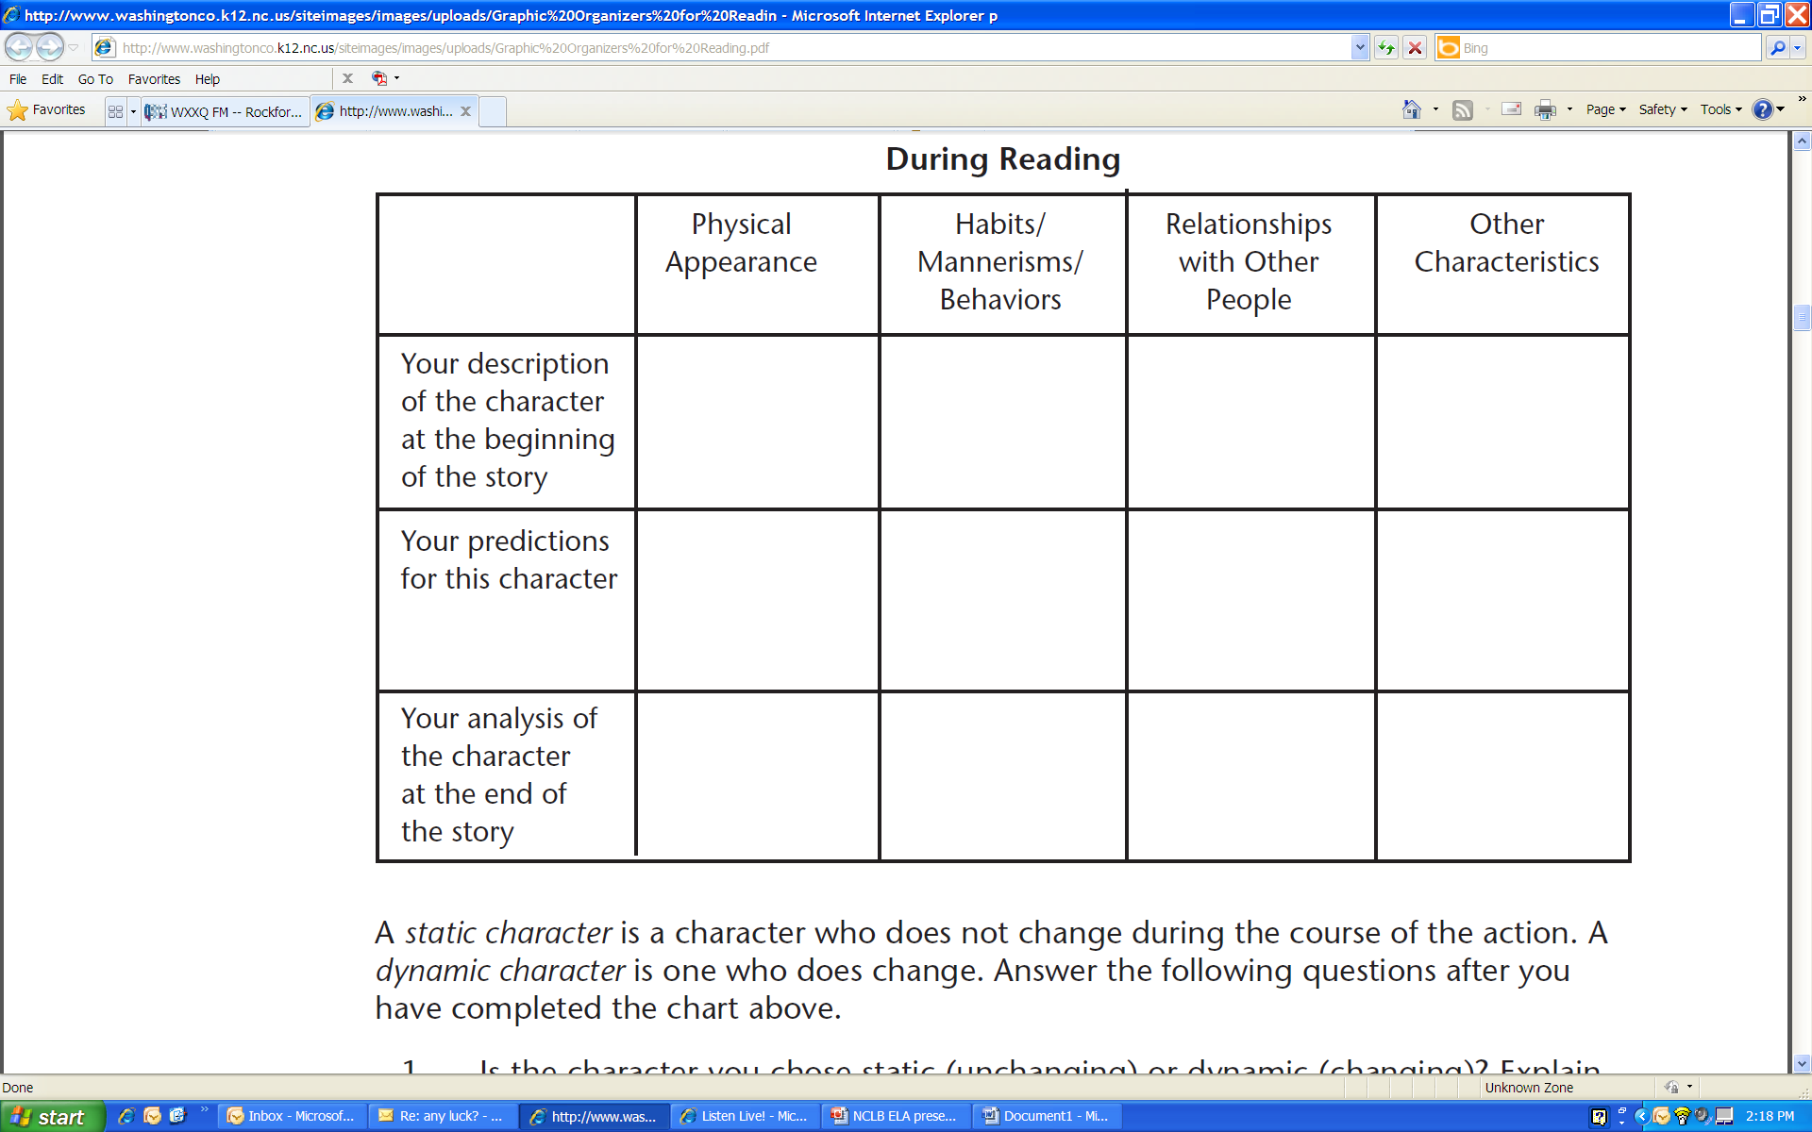
Notes:
The graphic organizer allows for student thought and analysis but then fosters reflection and can create a platform for dialogue in small groups. See next screen shot.

Slide 25
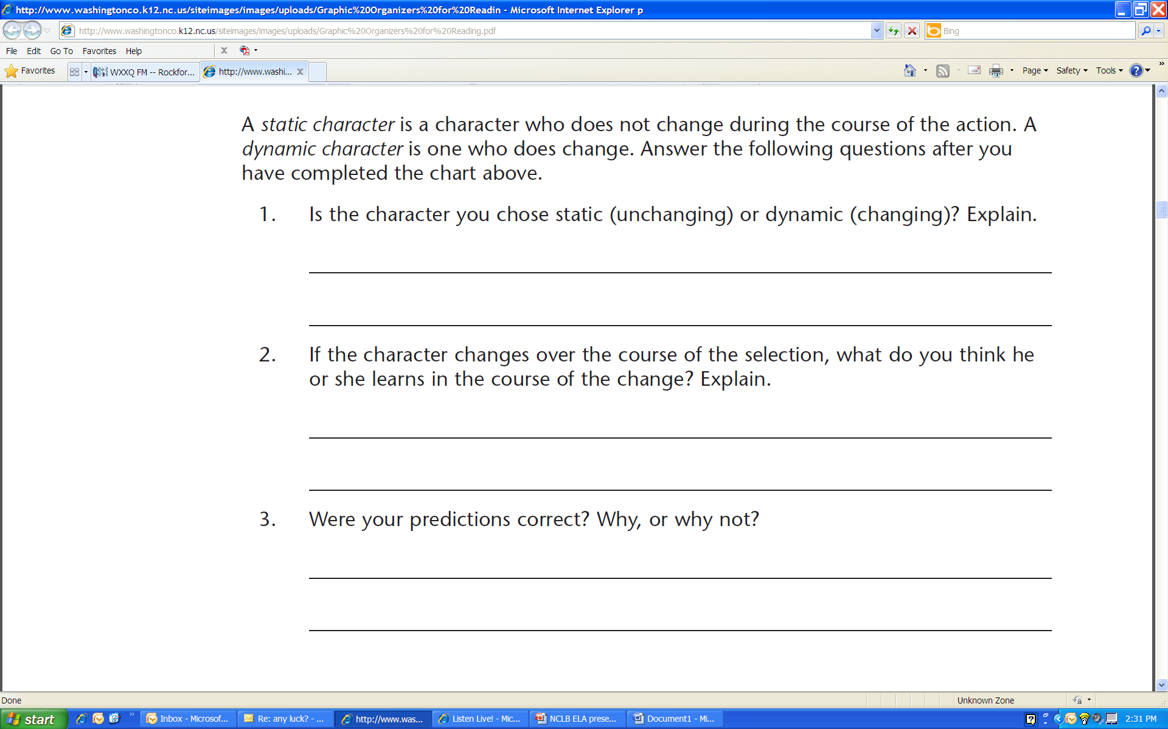
Notes:
Skills are taught about types of characters, but analyzing the characters’ actions and belief systems is a more critical thinking skill.

Slide 26
Resources
http://www.curriculum21.com/clearinghouse
Curriculum 21 provides a clearinghouse of resources for educators including curriculum mapping templates.
http://edsitement.neh.gov/lesson-plans
EDSITEment is a member of the Thinkfinity Consortium offering a library of free lesson plans in humanities.

Slide 27
Resources
http://www.fcrr.org
For a resource guide, summary table of supplemental reading programs or comprehensive reading programs view Florida Center for Reading Research.
http://ies.ed.gov/ncee/wwc/ *
The What Works Clearinghouse provides educators with information needed to make evidence-based decisions.
www.readwritethink.org
Read, write, think has literacy lesson plans for teachers for grades K-12.
Notes:
The Clearinghouse site hosts a wealth of materials and pdfs providing research-based information to consider when directing district and school level decisions.

Slide 28
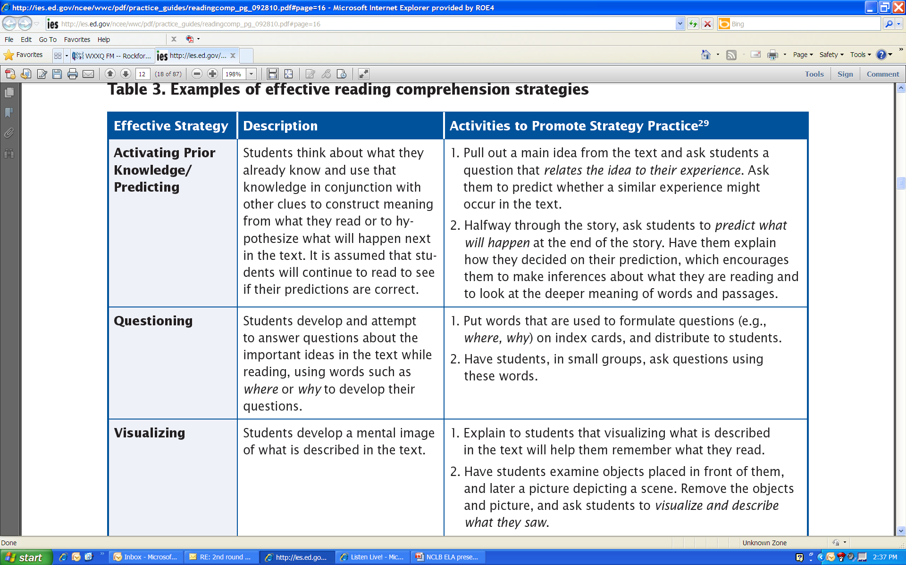
Notes:
This particular pdf shared recommendations of practices and strategies teachers can use. The suggested researched based comprehension strategies for elementary and primary grades are identified in the table.
Teachers explain to students how to use several strategies shown to improve reading comprehension because different strategies cultivate different kinds of thinking. Teachers explain how the strategies can help the students learn from text—as opposed to having them memorize the strategies—and how to use the strategies effectively.

Slide 29
Resources
www.bitstrips.com
Bitstrips is a comic strip creator for students.
http://www.ala.org/ala/mgrps/divs/yalsa/booklistsawards/booklistsbook.cfm
This site incorporates graphic novel booklists from the American Library Association.
www.thescriptorium.net
The scriptorium is a webzine for writers.

Slide 30
Resources
www.clrn.org/fdti/
Digital textbooks can be accessed on this site.
http://www.schooltube.com/videos
School Tube is a site that has royalty free music, videos and lesson plans for video production and digital storytelling.
http://www.teachertube.com/
Teacher Tube has videos, audio clips and photos.

Slide 31
Resources
http://www.curriki.org/
Curriki includes content area information for teachers, parents and students.
http://www.adlit.org/
Adolescent Literacy has resources for teachers including book lists, teaching strategies as well as research reports for parents and teachers of students grades 4-12.
http://www.khanacademy.org
Kahn Academy has a K-12 grade library of videos of lessons for students, parents and teachers.

Slide 32
Resources
http://tilesig.wikispaces.com/Cool+Tools
Tools to enhance literacy is from the Technology In Literacy Education Special Interest Group which is affiliated with the International Reading Association.
http://www.p21.org/storage/documents/P21CommonCoreToolkit.pdf *
This is a guide to align the Common Core Standards with the framework for 21st century skills.
Notes:
The P21 Framework is a framework for schools and districts to organize the relationship between the CCSS and the demands of other important content areas such as science, social studies, world languages, the arts and music that are also essential for student success. This particular pdf shares some examples of strategies to be employed in a 4th grade classroom.

Slide 33
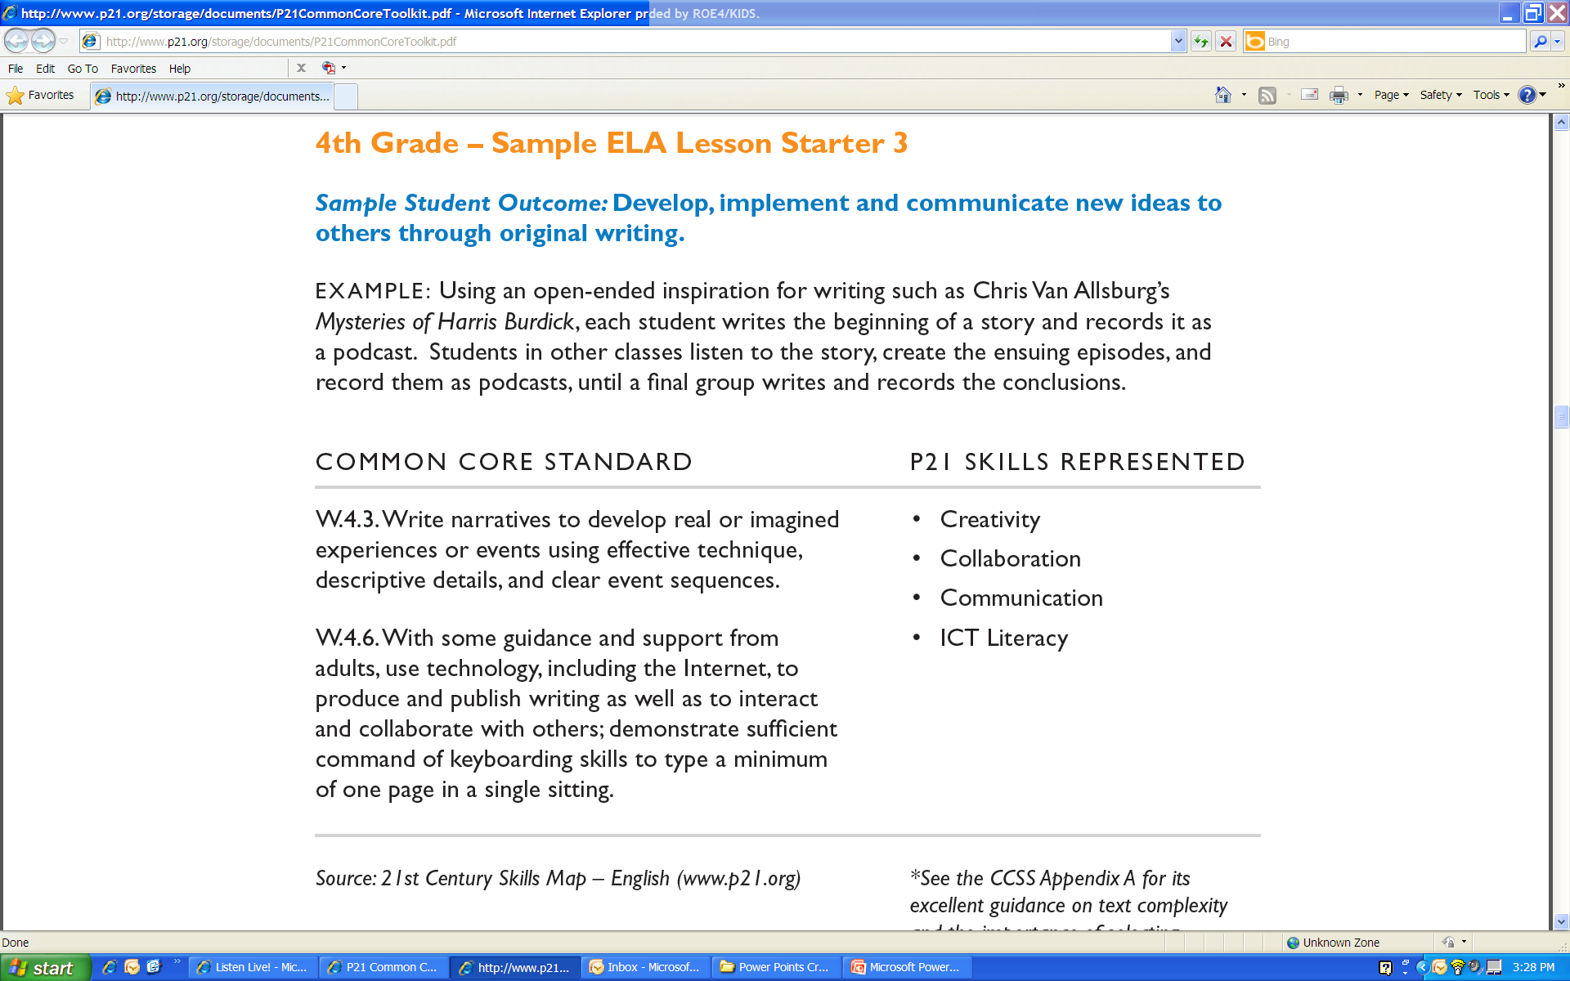
Notes:
Read slide and discuss the differences in requirements that CCSS and the role strategies will play within the classroom. It will now be important for students to not just know the strategies, but apply strategies and have opportunities to use them in group discussions and activities.

Slide 34
References
Beck, I.L., McKeown, M.G., & Kucan, L. (2002). Bringing words to life: Robust Vocabulary Instruction. NY: Guilford Press.
Coleman, D. (2011). Close reading of text: Letter from Birmingham jail, Martin Luther King Jr. Retreived January 25, 2012. http://engageny.org/resource/close-reading-of-text-mlk-letter-from-birmingham-jail/.

Slide 35
References
James B. Hunt Institute for Educational Leadership and Policy (2011). Issue Brief. Higher Ed and the Common Core Standards: Critical Connection. Retrieved January 5, 2012 http://www.hunt-institute.org/elements/media/files/2011_Hunt_SHEEO_meeting_issue_brief.pdf.

Slide 36
References
National Governors Association/Council of Chief State School Officers (2010). Common Core State Standards: English Language Arts. Retrieved January 11, 2012 from www.corestandards.org/the-standards .
National Governors Association/Council of Chief State School Officers (2010). Key Points in English Language Arts. Retrieved January 5, 2012 from http://www.corestandards.org/about-the-standards/key-points-in-english-language-arts.

Slide 37
Contact Information
Sarah McCusker, ISBE, Springfield smccuske@isbe.net (217) 524-4832
Erik Iwersen, Area I-A,B,D eiwersen@s-cook.org (708) 544-4891
Amy Robinson, Area I-C arobinson@dupage.k12.il.us (630) 495-6080
Jill Brown, Area II jbrown@kidsroe.org (815) 636-3060
Katy Sykes, Area III and IV ksykes@i-kan.org (815) 937-2950
Kathi Rhodus, Area V and VI krhodus@stclair.k12.il.us (618) 825-3900

