Slide 1
Math 6-8: The Standards in Practice:
A Common Core Lesson

Slide 2
Goals
• To experience an exemplar lesson that integrates both content and practice standards.
• To provide an opportunity for teachers to discuss the shifts necessary for implementing the CCSSM

Slide 3
The Standards in Practice
How can we weave the Standards for Mathematical Practice and the Content Standards into a coherent lesson?
Lets look deeply at a Common Core Lesson!
Notes:
Introduce Mathematics Assessment Project
CLASSROOM CHALLENGES
A Formative Assessment Lesson Interpreting Distance-Time Graphs
http://map.mathshell.org/materials/download.php?fileid=667
Say, “ Today we will walk through a model common core lesson.”
The facilitator could print out the entire lesson pdf and review it before doing the session.

Slide 4
Your Assignment
Student | Teacher
Do the lesson as your students would do the lesson. | Do the lesson with an eye toward the common core.
Notes:
Ask teachers to wear two hats during the session: Their teacher hat and their student hat.
Each slide has a graphic to guide this process

Slide 5
Journey to the Bus Stop
Work independently.
Complete Journey to the Bus Stop
Does the Graph Make Sense?
Source: Interpreting Distance- Time Graphs
For more details, visit: http://map.mathshell.org/materials/download.php?fileid=667
© 2012 MARS, Shell Center, University of Nottingham
Notes:
Pass out s-1 “Journey to the Bus Stop”
Teachers will look at a graph and determine if the graph makes sense.
http://www.map.mathshell.org.uk/materials/lessons.php?taskid=208&subpage=concept
After independent work Facilitator should open the floor for conversation about how 6th, 7th and 8th grade kids would do on this task.
This is a pre lesson assessment provided by the lesson from the Mathematics Assessment Project
CLASSROOM CHALLENGES
A Formative Assessment Lesson Interpreting Distance-Time Graphs
http://map.mathshell.org/materials/download.php?fileid=667

Slide 6
Starting Points
The “Journey to the Bus Stop” is provided as a pre- and post-assessment tool.
Collect handout from students without discussion and look for common issues.
What misconceptions might occur?
Start the lesson after evaluating
student responses.
Notes:
After independent work Facilitator should open the floor for conversation about how 6th, 7th and 8th grade kids would do on this task.
This is a pre-lesson assessment provided by the lesson from the Mathematics Assessment Project
CLASSROOM CHALLENGES
A Formative Assessment Lesson Interpreting Distance-Time Graphs
http://map.mathshell.org/materials/download.php?fileid=667
Be sure to tell teachers that a list of common issues is provided in the Lesson.

Slide 7
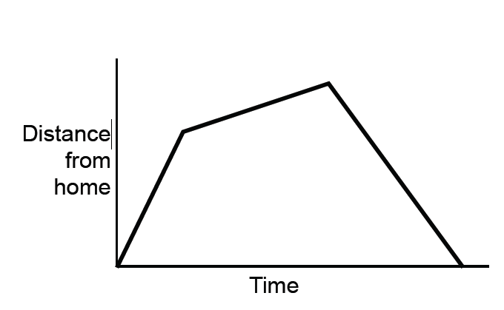
Matching a Graph to a Story
A. Tom took his dog for a walk to the park. He set off slowly and then increased his pace. At the park Tom turned around and walked slowly back home.
B. Tom rode his bike east from his home up a steep hill. After a while the slope eased off. At the top he raced down the other side.
C. Tom went for a jog. At the end of his road he bumped into a friend and his pace slowed. When Tom left his friend he walked quickly back home.
Notes:
This is the whole class introduction to matching graphs and descriptions.
• Ask participants to find the description that matches the graph.
• Ask them to write two reasons to support their decision.
• After 2-3 minutes ask students who selected A to explain his or her thinking by explaining each part of the graph.
• Students could record their thinking on chart paper, Smart board or white board.
• After a student explains choice A
• Ask for a volunteer to explain and draw B and then C.
• Encourage participants to challenge each other’s interpretations.

Slide 8

Let’s Work Together!
Move into groups of three.
You will be given handouts with ten graph cards and ten story cards. Carefully cut out the cards.
In your group, take turns matching cards.
Tape the graph cards on the poster next to the description cards.
Write your reasons for your choices next to your matched cards. Explain each line segment.
If you think there is no suitable card that matches, write one of your own.
Notes:
Distribute s-2 through s-4 ( Card Sets A and B)
Remind participants to leave space for another card.
( the tables Card set C will be distributed later)
Tell participants they will need to share their posters.
Presenter should model moving to group to group and making notes about student approaches.

Slide 9
Sharing Posters
• One student from each group is to visit another group’s poster.
• If you are staying at your desk, be ready to explain the reasons for your group's matches.
• If you are visiting another group:
  Write your card placements on a piece of paper.
  Go to another group’s desk and check to see which matches are different from your own.
  If there are differences, ask for an explanation. If you still don’t agree, explain your own thinking.
  When you return to your own desk, you need to consider as a group whether to make any changes to your own poster.
Notes:
For the bullet that says write your card placements on a piece of paper:
Students can jot down,
“ I put Graph A with description 1” etc.
before leaving their table, to keep track of their choices.

Slide 10

Reflect on Part 1
Take a few minutes to write your thoughts about part one of the lesson.
What would you see in your classroom?
What surprises would you anticipate?
What are the challenges to facilitating the lesson.
Other thoughts…
Notes:
Lead a Think- Ink – Pair –Share Discussion
Think--First ask participants to consider the questions
Ink-- Then write their thoughts on paper
Pair—Then ask them share with a shoulder partner
Share-Then share with the larger group

Slide 11
Making Up Data for a Graph
Time | Distance
0
2
4
6
8
10
Notes:
Ask teachers to look at the graph and fill in the table on their own papers.
Discuss possible answers.
Note: this graphic is provided as a launch to the second day of the lesson

Slide 12
Matching Data
In your group, take a graph and try to find a table that matches it.
Take turns matching the remaining cards.
Each time you do this explain your thinking clearly and carefully.
Write your reasons for the match on the poster.
Display your poster when complete.
Notes:
Distribute Card Set C (s-5)
Ask teachers to cut out the cards and match new graphs with their previous matches.
Participants should display their matches and reasons on the poster.

Slide 13

Analyze the Lesson
What mathematical content was developed during this lesson?
Which Practice Standards would students employ?
How could you use the strategies that were illustrated today to help implement the CCSS?
Notes:
Distribute the Standards for Mathematical Practice
Remind participants that these are things that mathematically proficient students should be able to do.
Mathematical Practice Standards 2 and 3 are evident but participants might see others as well.
You may also direct them to page 55 of the CCSSM to read the functions domain for 8th grade.
According to the lesson this is aligned to 8.F while a point could be made that it also begins to develop 6.EE.9 ( page 44)
After teachers have time to Analyze, open the discussion to the larger group.
You will link to the actual lesson on the next slide.

Slide 14

Resources
http://map.mathshell.org/materials/lessons.php?taskid=208&subpage=concept
Notes:
Click on this page to reveal the entire Interpreting Distance Time Graph Lesson
Show teachers they can click on Lessons /Middle school for more complete lessons aligned to the Common Core Content and practices.
This resource is the Mathematics Assessment Project CLASSROOM CHALLENGES
http://www.map.mathshell.org.uk/materials/lessons.php?taskid=208&subpage=concept
Below is the link to the lesson pdf
A Formative Assessment Lesson Interpreting Distance-Time Graphs
http://map.mathshell.org/materials/download.php?fileid=667

Slide 15
Final Thoughts
Notes:
Ask participants to complete feedback or evaluation forms as necessary

