Slide 1
Unpacking the English Language Arts Common Core State Standards
  By
  Illinois State Board of Education
  English Language Arts
  Content Area Specialists

Slide 2
Purposes/Outcomes
Understand overall structure and layout of the English Language Arts Common Core State Standards (CCSS).
Engage in processes and activities that may be utilized in your school or district.
Notes:
This slide provides the audience with description of the purpose behind the presentation.

Slide 3
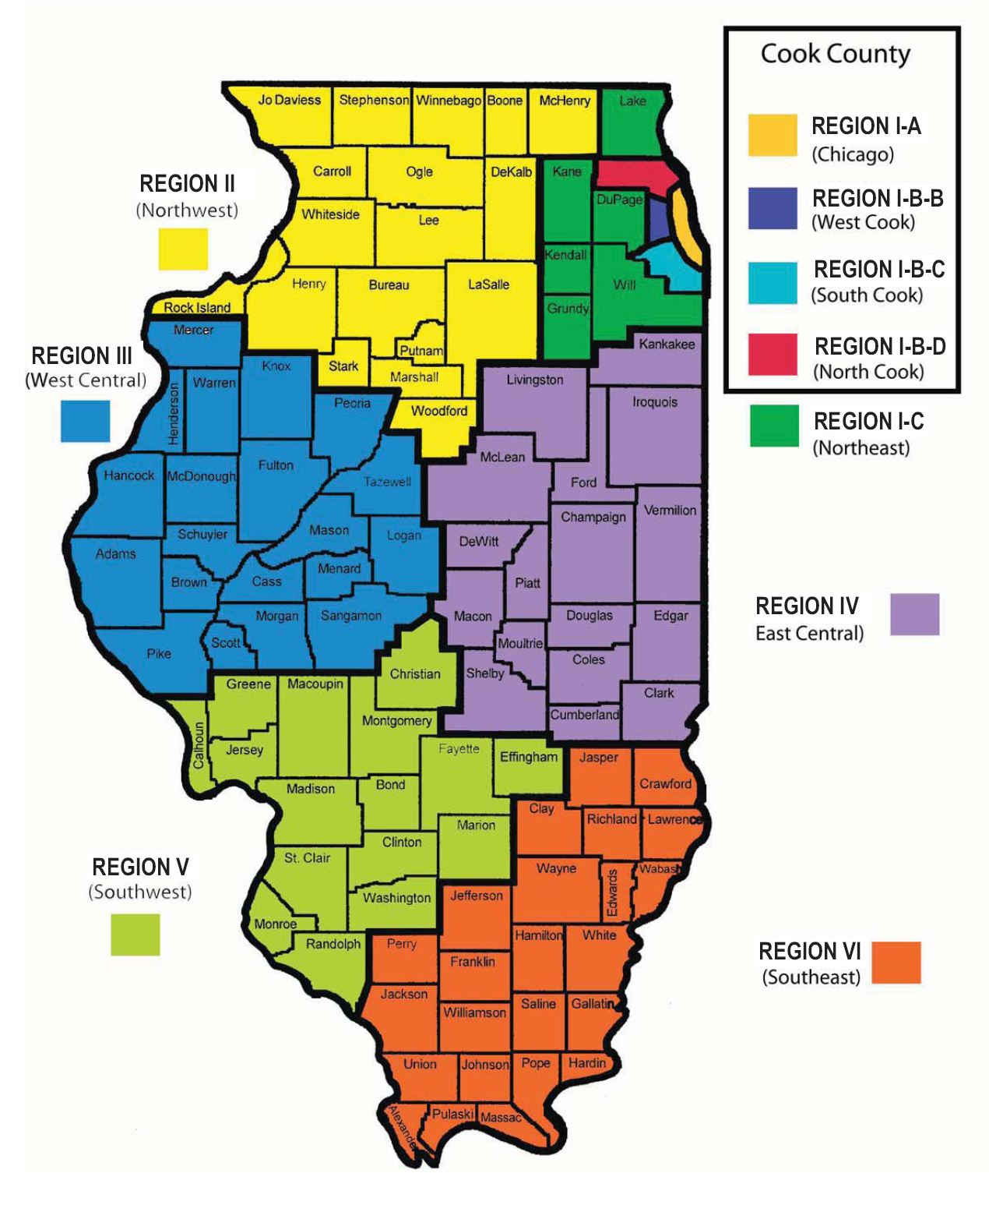
Kathleen McNeary
Area IA
Erik Iwersen
Area I-BB, BC, BD
Amy Robinson
Area I-C
Jill Brown
Area II
Katy Sykes
Area III and IV
Kathi Rhodus
Area V and VI
Notes:
Currently, there are six English Language Arts Content Area Specialists with the Illinois State Board of Education. Each specialist is housed out of local offices. This group works to create and provide resources for stakeholders throughout Illinois as we transition to the Common Core State Standards.

Slide 4
English Language Arts
Common Core Standards
Reading Strand
Writing Strand
Speaking and Listening Strand
Language Strand
Key Ideas and Details
Craft and Structure
Integration of Knowledge
and Ideas
Range of Reading and Level of Text Complexity
Text Types and Purposes
Production and Distribution
of Writing
Research to Build Knowledge
Range of Writing
Comprehension and Collaboration
Presentation of Knowledge
and Ideas
Conventions of
Standard English
Knowledge of Language
Vocabulary Acquisition and Use
http://www.education.ohio.gov/
Notes:
Visual graphic of the English Language Arts Strands and the topics/clusters included in each strand.

Slide 5
Questions to Consider
1. Pick a GRADE LEVEL and read the Standards vertically for that grade.
What resonates with you? What’s
the same? What is different?
2. Pick a STANDARD and read that Standard horizontally across the K-12 continuum.
What do you notice?
BB
Notes:
The following is an exercise that will assist participants in becoming familiar with the standards and their progression.
Participants should have a copy of the standards for their grade level available to them. At this point in the presentation, ask participants to look at their grade level and read them vertically. What skills seem to jump out that may be different than they have ever taught before? What skills are they already employing? What standards do they have resources for? What standards will they need more professional development for? Share these thoughts with the partners or table mates.
Follow the same procedure as above but choose only one standard and follow it across grade levels from K-12. Discuss the same questions as above and share with table partners.

Slide 6
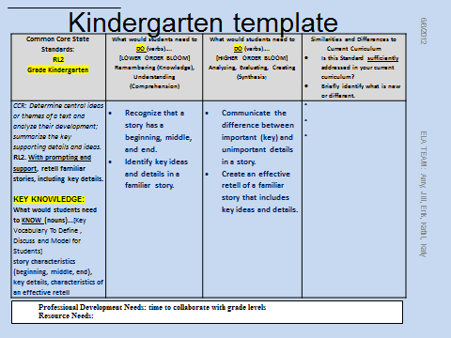
Notes:
This is a sample template for kindergarten. Walk participants through this template of what a group of Kindergarten teachers filled out to unpack RL.2. Remind participants that this is just one example of what one group of teachers did to unpack the standard.

Slide 7
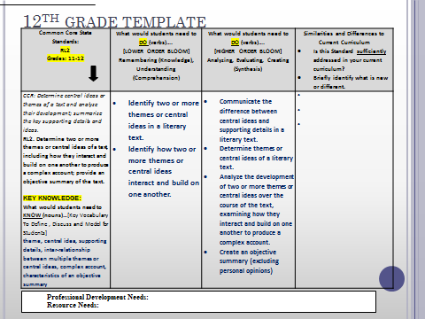
12th Grade Template
Notes:
Have participants compare the 12th grade template with the kindergarten one and discuss the differences between the two of them. Walk participants through this template of what a group of 12th grade teachers filled out to unpack RL.2. Remind participants that this is just one example of what one group of teachers did to unpack the standard.

Slide 8
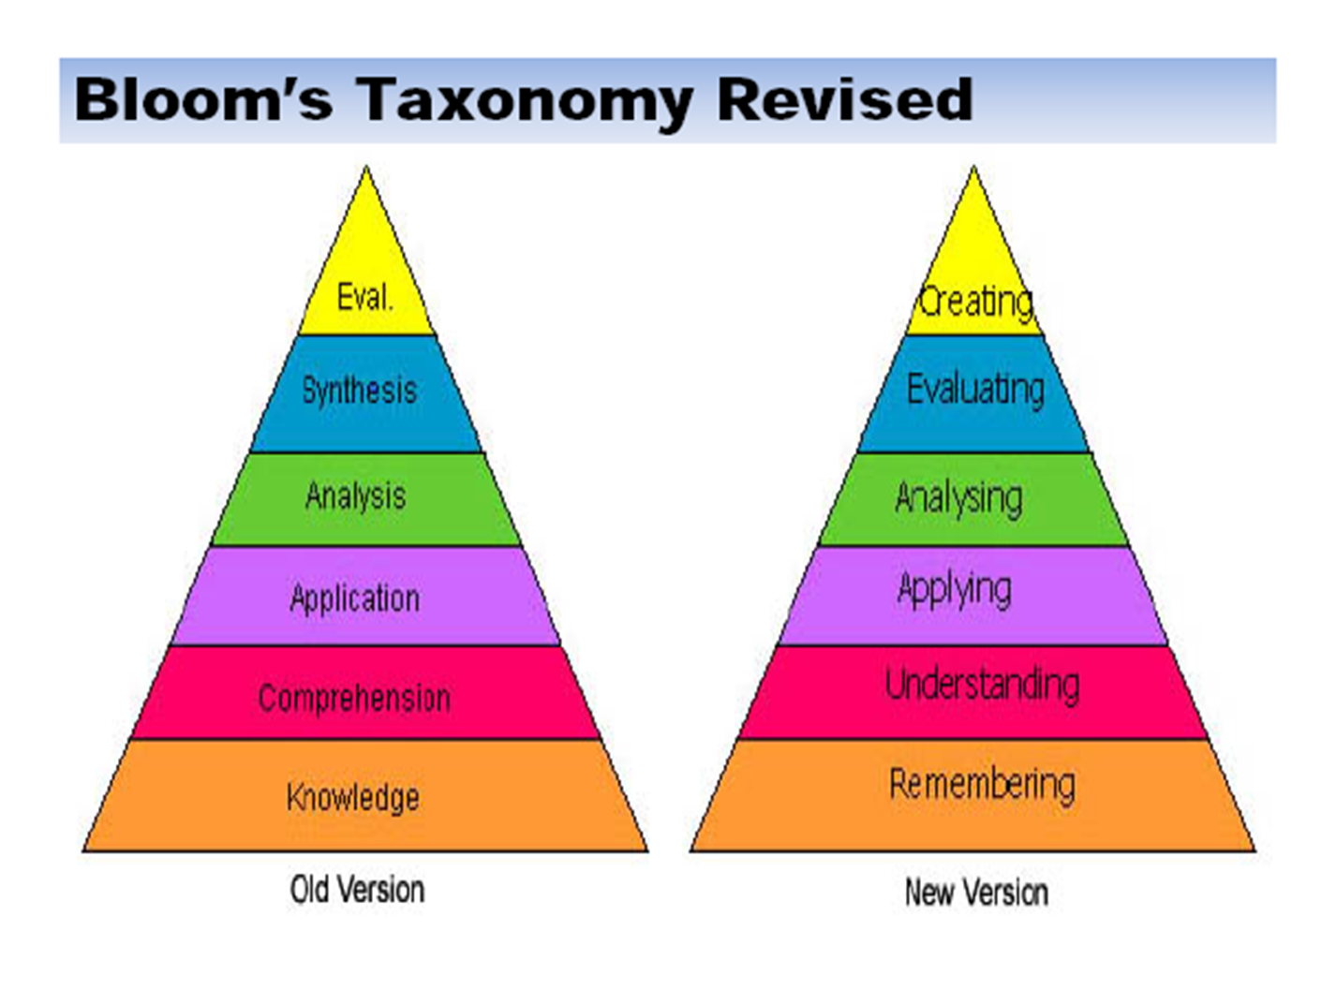
Notes:
Use this slide to remind participants about the levels of questions that students need to be exposed to and accountable for answering. Critical thinking is a key shift that most teachers should understand from previous training which they have had. Given that as a basis for where they could begin the implementation process will be easily done if a school/district utilizes a critical thinking model. This slide shares Bloom’s original taxonomy and the revised taxonomy by Anderson and Krathow in 2001.

Slide 9
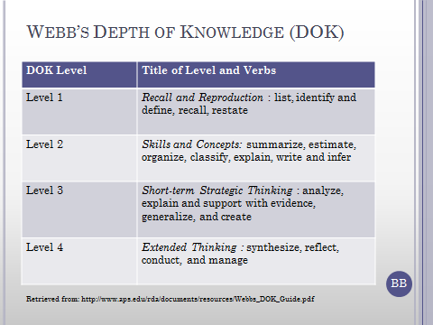
Webb’s Depth of Knowledge (DOK)
Notes:
This slide shows another model for teachers to consider when looking at what students should be doing to show mastery of the common core standards.
Level 1: Curricular elements that fall into this category involve basic tasks that require students to recall or reproduce knowledge and/or skills. The subject matter content at this particular level usually involves working with facts, terms and/or properties of objects. It may also involve use of simple procedures and/or formulas. Key words that often denote this particular level include list, identify and define. A student answering a Level 1 item either knows the answer or does not; that is, the answer does not need to be “figured out” or “solved.”
Level 2: includes the engagement of some mental processing beyond recalling or reproducing a response. This level generally requires students to contrast or compare people, places, events and concepts; convert information from one form to another; classify or sort items into meaningful categories ; describe or explain issues and problems, pattern, cause and effect, significance or impact, relationships, points of view or processes.
Level 3: Items falling into this category demand a short-term use of higher order thinking processes, such as analysis and evaluation, to solve real-world problems with predictable outcomes. Stating one’s reasoning is a key marker of tasks that fall into this particular category. The expectation established for tasks at this level tends to require coordination of knowledge and skill from multiple subject-matter areas to carry out processes and reach a solution.
Level 4: Curricular elements assigned to this level demand extended use of higher order thinking processes such as synthesis, reflection, assessment and adjustment of plans over time. Students are engaged in conducting investigations to solve real-world problems with unpredictable outcomes.

Slide 10
Your Turn: Unpacking the Standards
1. Analyze what students to know (nouns), and
2. be able to do (verbs) to demonstrate mastery of this standard.
3. Classify these items under columns 2 or 3
    Column 2 – lower level thinking skills
    Column 3 – higher level thinking skills
Notes:
The next two slides explains the steps of the unpacking process

Slide 11
4. Reflect on the similarities and differences to your current curriculum. (4th column)
5. Consider the support needed to implement this standard with fidelity. (bottom of template)
Notes:
These are the final steps of the unpacking process. . Hand out a blank “Unpacking Template”. Have participants choose a standard from their grade level. Ask them to independently, with partners, or in a small group, unpack that standard on the template.

Slide 12
Unpacking
Discoveries!
Notes:
Ask participants to share out what they discovered when completing the template.

Slide 13
Contact Information
Dr. Amy Robinson
arobinson@dupage.k12.il.us
Katy Sykes
ksykes@i-kan.org
Notes:
If you have any questions or need additional information, here is the contact information for the ELA English Language Arts Content Area Specialists.

